Slide 1
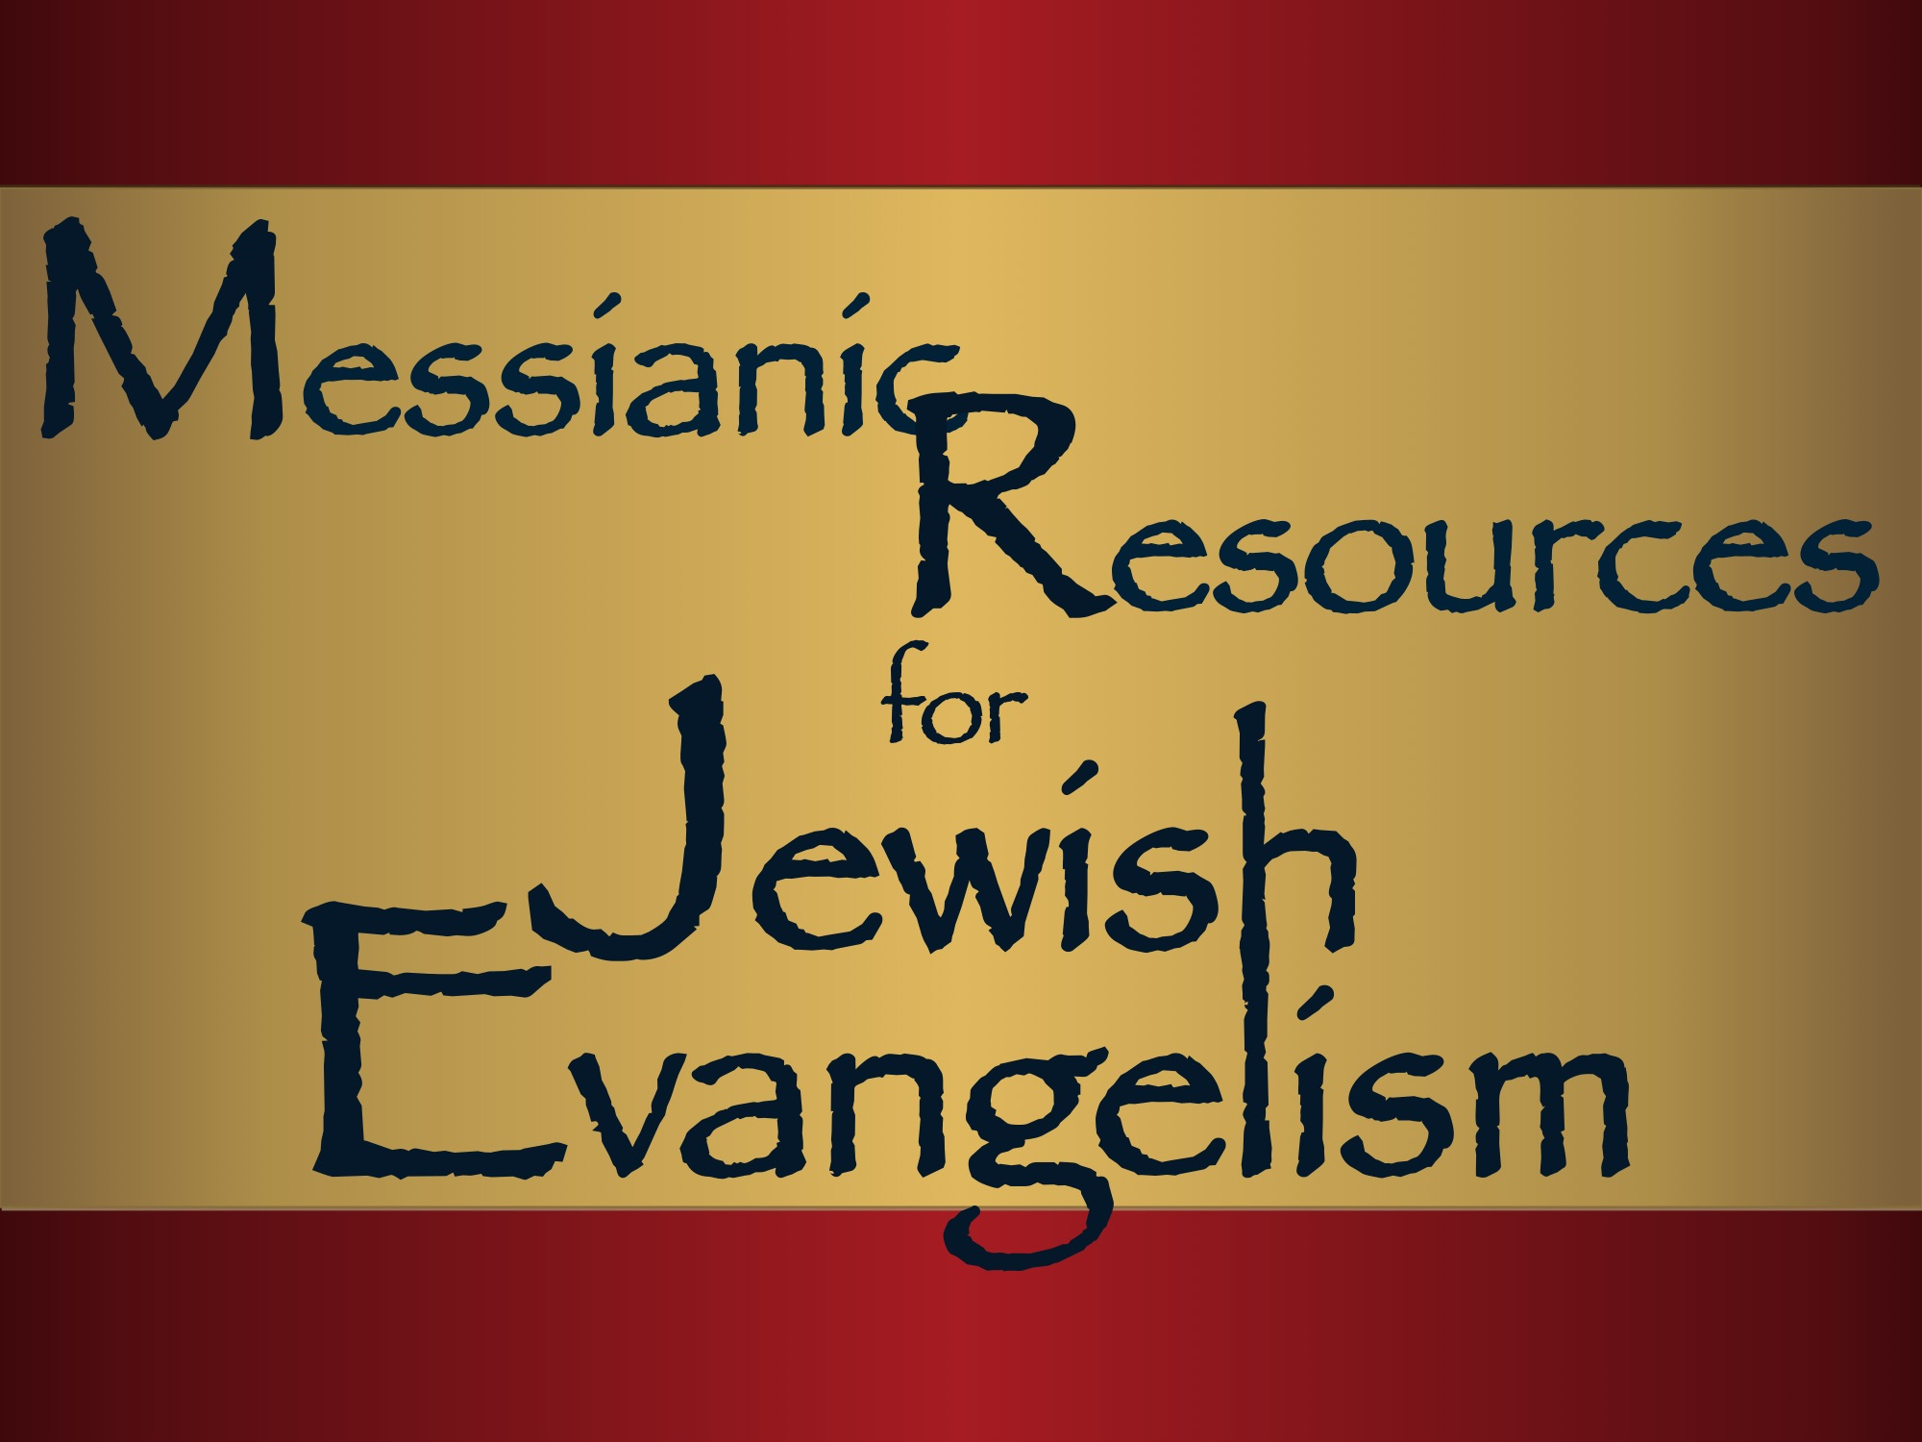
Notes:
Shalom Friends,
I'm sorry I'm not able to be with you all at the LCJE—Jersualem. However, I hope that this Power Point presentation accomplishes what I would have liked to have shared.
Essentially, because my ministry is all about publishing and producing resources, as well as finding other products and making them available to our community, we were able to pull these together for the LCJE. We contacted most, if not all, the Jewish missions and got a good response.
This slide presentation starts with fairly recent items, from organizations and individuals, that you could use to help our people meet the Messiah. Slides you may have seen before come later. I wanted to include them since you may not be familiar with the breadth of resources available to your ministry.
Again, thanks for letting me share this with you. I wish I could have been with you.
Shalom in Yeshua,
Barry Rubin

Slide 2
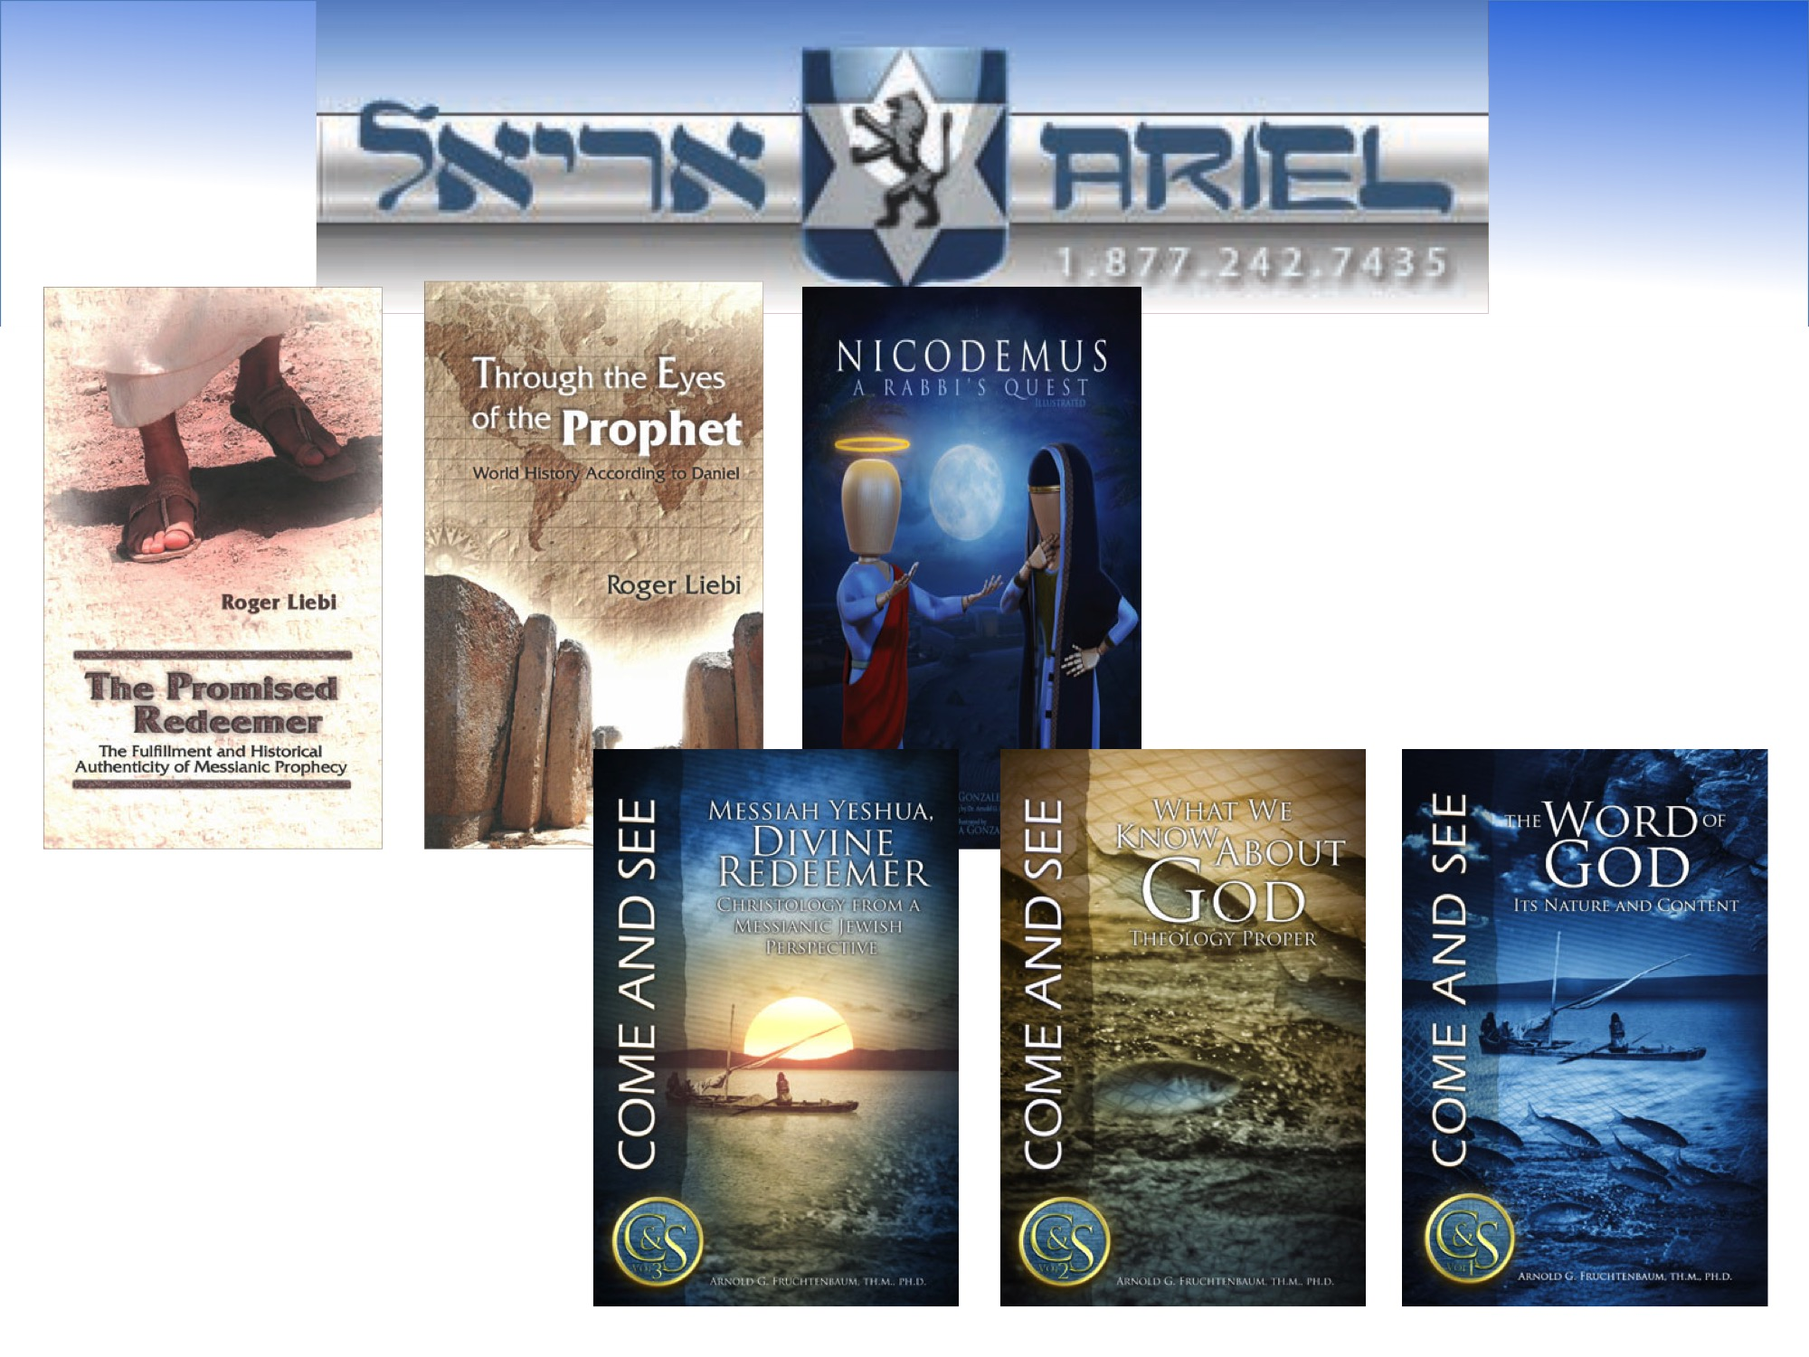
Notes:
http://www.arielc.org
The Promised Redeemer:
The Fulfillment and Historical Authenticity of Messianic Prophecy
by Roger Liebi
When reading the Old Testament one gets a profound impression of the yearning and longing for a coming Redeemer, the Messiah, who would eliminate man’s basic problem and bring in everlasting righteousness. This promised Messiah is described in the minutest detail in the writings of the Old Testament. These writings deal with over 330 astonishingly precise and extremely different prophecies. In this book it will be proven demonstratively that these prophecies have been literally fulfilled in the historical Jesus of Nazareth.
Through the Eyes of the Prophet:
World History According to Daniel
by Roger Liebi
This book contains detailed prophecy which extends over millennia and yet is infallibly fulfilled. With the help of the prophet Daniel, Roger Liebi shows us a concrete view of the future whose reliability and precision are supported impressively by over 200 fulfilled prophecies on the subject of world history.
Nicodemus, A Rabbi’s Quest Illustrated
by Jesse and Joshua Gonzales
“From scholarly to simply illustrated, every issue of Illustrated Messianic Bible Studies brings to you a visually enhanced study of God’s Word from a Messianic Jewish Perspective.”
There are many New Testament passages of scripture that require a knowledge of the Jewish frame of reference to be understood, even familiar ones. One such passage is the discussion between Jesus and Nicodemus on the new birth. In this work, Jesse Gonzales provides that kind of understanding.
24 pages of Full-Color Illustrations
Messiah Yeshua, Divine Redeemer: Christology from a Messianic Jewish Perspective
by Dr. Arnold Fruchtenbaum
C&S Volume 3: The Come and See series is a multi-volume collection of Messianic Bible Studies transcribed from Dr. Arnold Fruchtenbaum’s original radio broadcasts. Each study is a solid foundation upon which you can stand or from which you can teach. The texts will edify you in your personal devotion or small group Bible study regardless of which topic you choose.
Volume 3 of Come and See is a comprehensive study of the Son of God. Dr. Fruchtenbaum’s unique focus of looking at Yeshua (Jesus) from a Messianic Jewish perspective adds a dimension to this field of systematic theology that is often missing in the church today. The author works his way through the Hebrew Scriptures and shows how the revelation of the Messiah gradually progressed to reveal a magnificent picture of the Deliverer to come. The study of the life of the Messiah and theologically relevant topics, such as the Incarnation and the Crucifixion, profits from this Jewish frame of reference as well. The questions and study suggestions at the end of the chapters will challenge anyone who desires to dig deeper into the Word of God.
Paperback, glossy: 232 pages $15.00
What We Know About God: Theology Proper
by Dr. Arnold Fruchtenbaum
Volume 2 of Come and See examines the nature, attributes, and persons of God. It investigates the names of God in the Old and New Testament and what they tell us about His character and work. The Trinity is examined in detail, followed by a study of God the Father. Each chapter contains challenging questions and study suggestions that make this book an excellent tool for anyone who desires to acquire a deeper understanding of who God is.
Paperback, glossy: 138 pages $13.00
The Word of God: Its Nature and Content
by Dr. Arnold Fruchtenbaum
Volume 1 of this series entitled “The Word of God” was previously released as a collection of five thematically related Bible studies (030 - The Nature of the Bible, 034 - The Bible and Divine Revelation, 037 - The Inspiration of the Scriptures, 021 - The Eight Covenants of the Bible, and 041 - The Dispensations of God) pertaining to the Bible itself, an area of systematic theology known as Bibliology. In this new release, those original Bible studies are now supplemented with significantly revised and expanded material from Arnold Fruchtenbaum’s Systematic Theology courses. Each chapter freshly integrates study questions and suggestions to help you apply what you have learned to your life. Every chapter also concludes with an opportunity to take an online test pertaining to the study.
The ideal target audience for this study includes: young believers, small group Bible studies, those who wish to establish a firm foundation of their understanding of God, and teachers.
Paperback, glossy: 144 pages $13.00

Slide 3
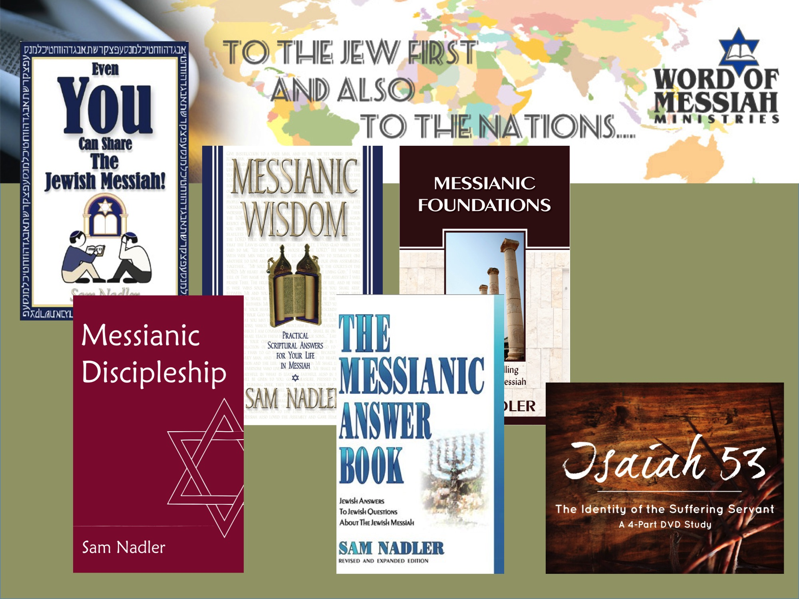
Notes:
Word of Messiah Ministries
Sam Nadler
www.wordofmessiah.org
Messianic Discipleship
For one-on-one discipleship, this book walks through Scripture’s teaching regarding identity in Messiah and provides core teaching on the spiritual disciplines of prayer, fellowship, studying God’s Word, and sharing the faith. Teaches about the Oral Law, the divinity of Yeshua, the Tri-unity of God, and the Jewishness of Immersion and the Lord’s Supper.
The Messianic Answer Book
Designed for believers to use in their witness to Jewish people. In the back of the book are several testimonies of Jewish people who have come to faith in their Messiah. Each of the questions covered in are available in pamphlet form as free downloads from Word of Messiah’s bookstore:
http://www.wordofmessiahbookstore.com/Free-Downloads
Even You Can Share the Jewish Messiah
A short booklet that will prepare someone to sensitively and effectively share the love of Messiah with Jewish friends, family members, co-workers, and neighbors.
Messianic Foundations
Whether Jewish or Gentile, all believers are called to represent God’s character and faithfulness in the world. Why are Messianic congregations necessary? Why must the Good News be “to the Jew first?” What does the “fullness of the Gentiles” mean? This book explores foundational matters which clarify what it means to be faithful to the God of Israel.
Messianic Wisdom
Practical, scriptural counsel about critical areas: Understanding identity as a Messianic Jewish or Gentile believer in Yeshua, Torah and the Messianic believer, choosing a place of worship, sharing the faith with unbelieving family members, Messianic marriage, faith and finances, the celebration of holidays, bar mitzvahs, and other events in Jewish life.

Slide 4
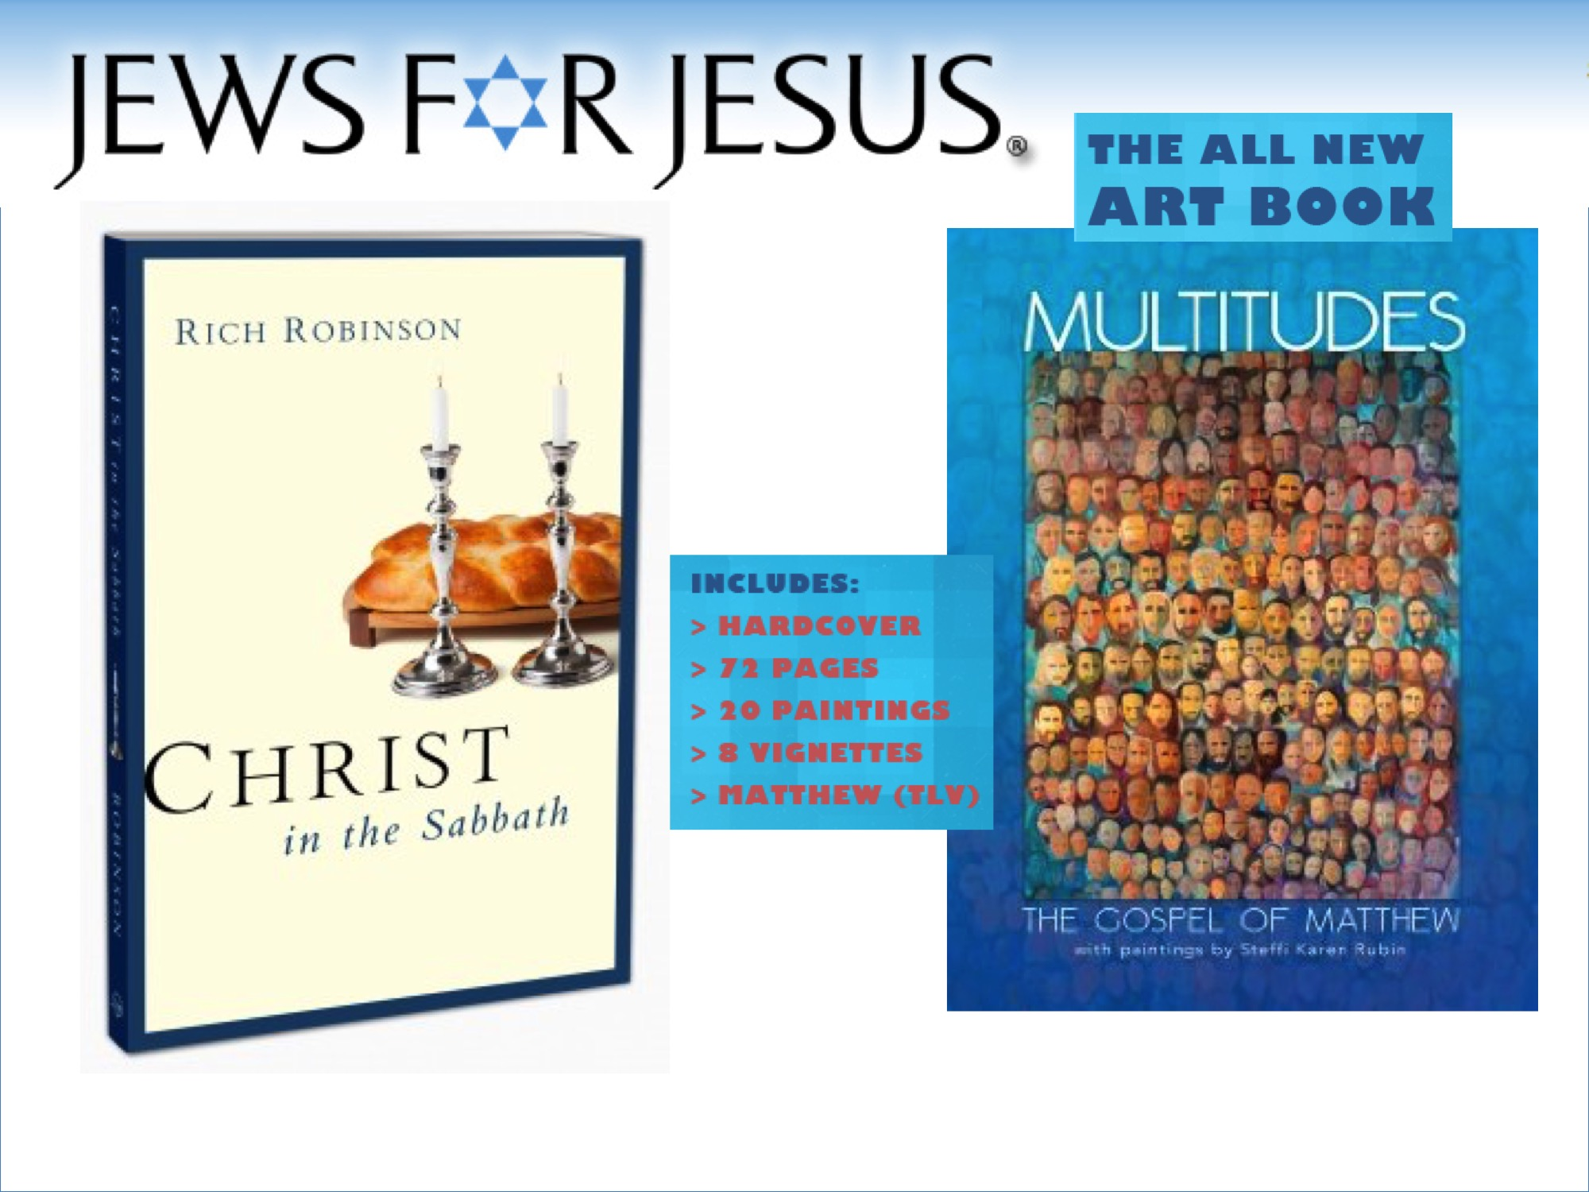
Notes:
Jews for Jesus
www.jewsforjesus.org
Christ in the Sabbath
looks at the meaning of the day in the Tanach and Brit Chadasha. Above all, Shabbat is fulfilled in Yeshua, who said “Come to me, all you who are weary and burdened, and I will give you rest.”
Includes chapters on the Sabbath in Jewish tradition and folklore, modern Jewish observance, its relation to Sunday in church history, and the variety of approaches modern believers—including Messianic Jews—take to its observance.
Multitudes Fine Art Book
The Gospel of Matthew Illustrated, a collection of art by artist Steffi Rubin. Each chapter of Matthew is associated with an original painting (20) or vignette (8).

Slide 5
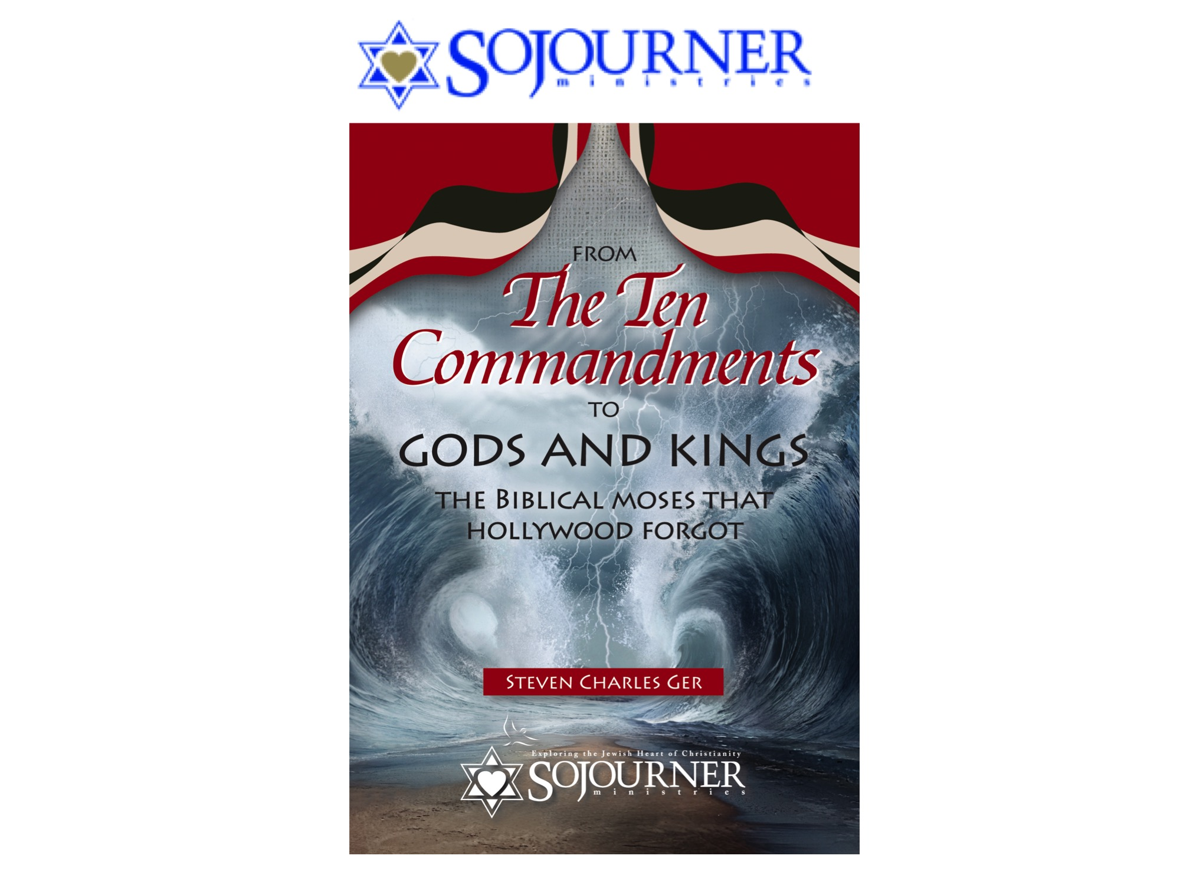
Notes:
Sojourner Ministries
www.sojournerministries.com
The Biblical Moses that Hollywood Forgot - Audiobook by Steven Ger
Moses is the towering personality of the Hebrew Scriptures. This
prince of Egypt, shepherd, prophet, mediator and sea-parter is at the core
of both Judaism, in his identity as both proto-prophet and lawgiver,
and Christianity, in his role as typological progenitor of the Messiah, the
“prophet like unto Moses.” Within these texts we find a man of great interest, whose complexity, humanity and grandeur far surpass Hollywood’s best Technicolor notions.
Steven Charles Ger, founder and director of Sojourner Ministries,
is the author of Acts: Witnesses to the World and Hebrews: Christ is Greater, Exploring Bible Prophecy from Genesis to Revelation and host of the DVD, The Unleavened Messiah: A Portrait of Christ in the Passover.

Slide 6
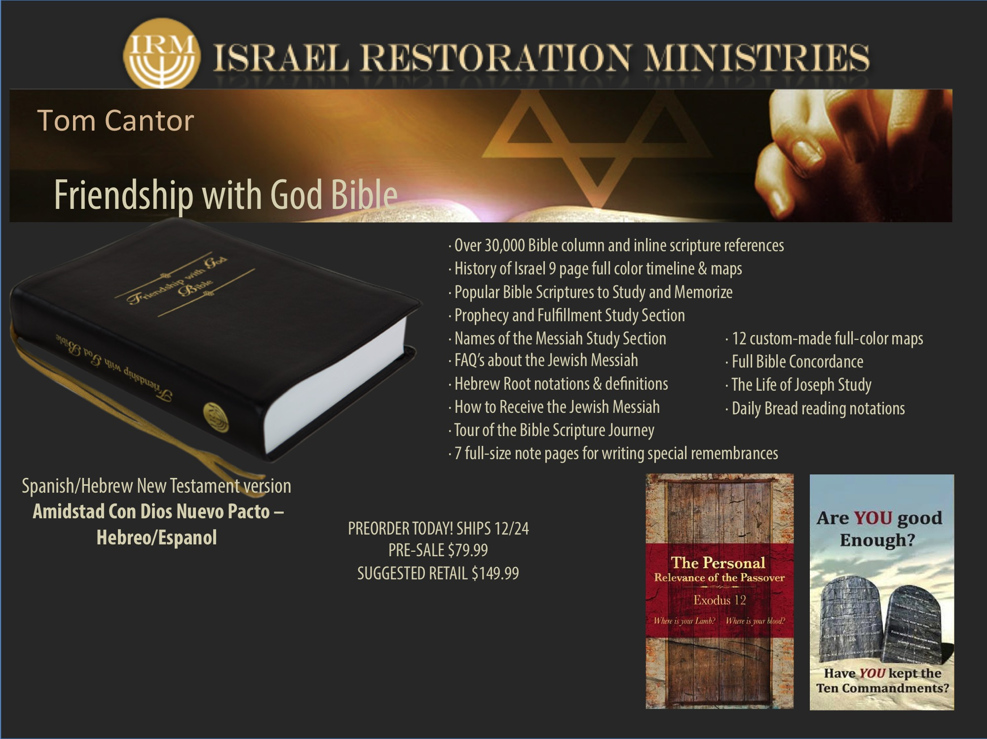
Notes:
Israel Restoration Ministries
http://www.israelrestoration.org
New Friendship with God Study Bible
Four years in the making! This amazing Study Bible features some of the greatest Messianic resources and Jewish Bible study helps available on the market. It’s available online at www.FriendshipwithGod.org under Resources and Tom Cantor Materials.
THIS GENUINE LAMBSKIN LARGE PRINT BIBLE FEATURES:
• Over 30,000 Bible column and inline scripture references
• 12 custom-made full-color maps
• History of Israel 9 page full color timeline & maps
• Full Bible Concordance
• Popular Bible Scriptures to Study and Memorize
• Prophecy and Fulfillment Study Section
• Names of the Messiah Study Section
• The Life of Joseph Study
• FAQ’s about the Jewish Messiah
• Hebrew Root notations & definitions
• How to Receive the Jewish Messiah
• Tour of the Bible Scripture Journey
• Daily Bread reading notations
• 7 full-size note pages for writing special remembrances
Offering a Spanish/Hebrew New Testament version of this Bible called Amidstad Con Dios Nuevo Pacto – Hebreo/Espanol
Launching in the Fall the “Personal Relevance of the Passover”, which is a small 26 page booklet on the Passover, with Old Testament prophecy and practices shown in light of the New Testament application in the Lord Jesus Christ, and a new 10 Commandment English Orthodox emphasis tract.

Slide 7
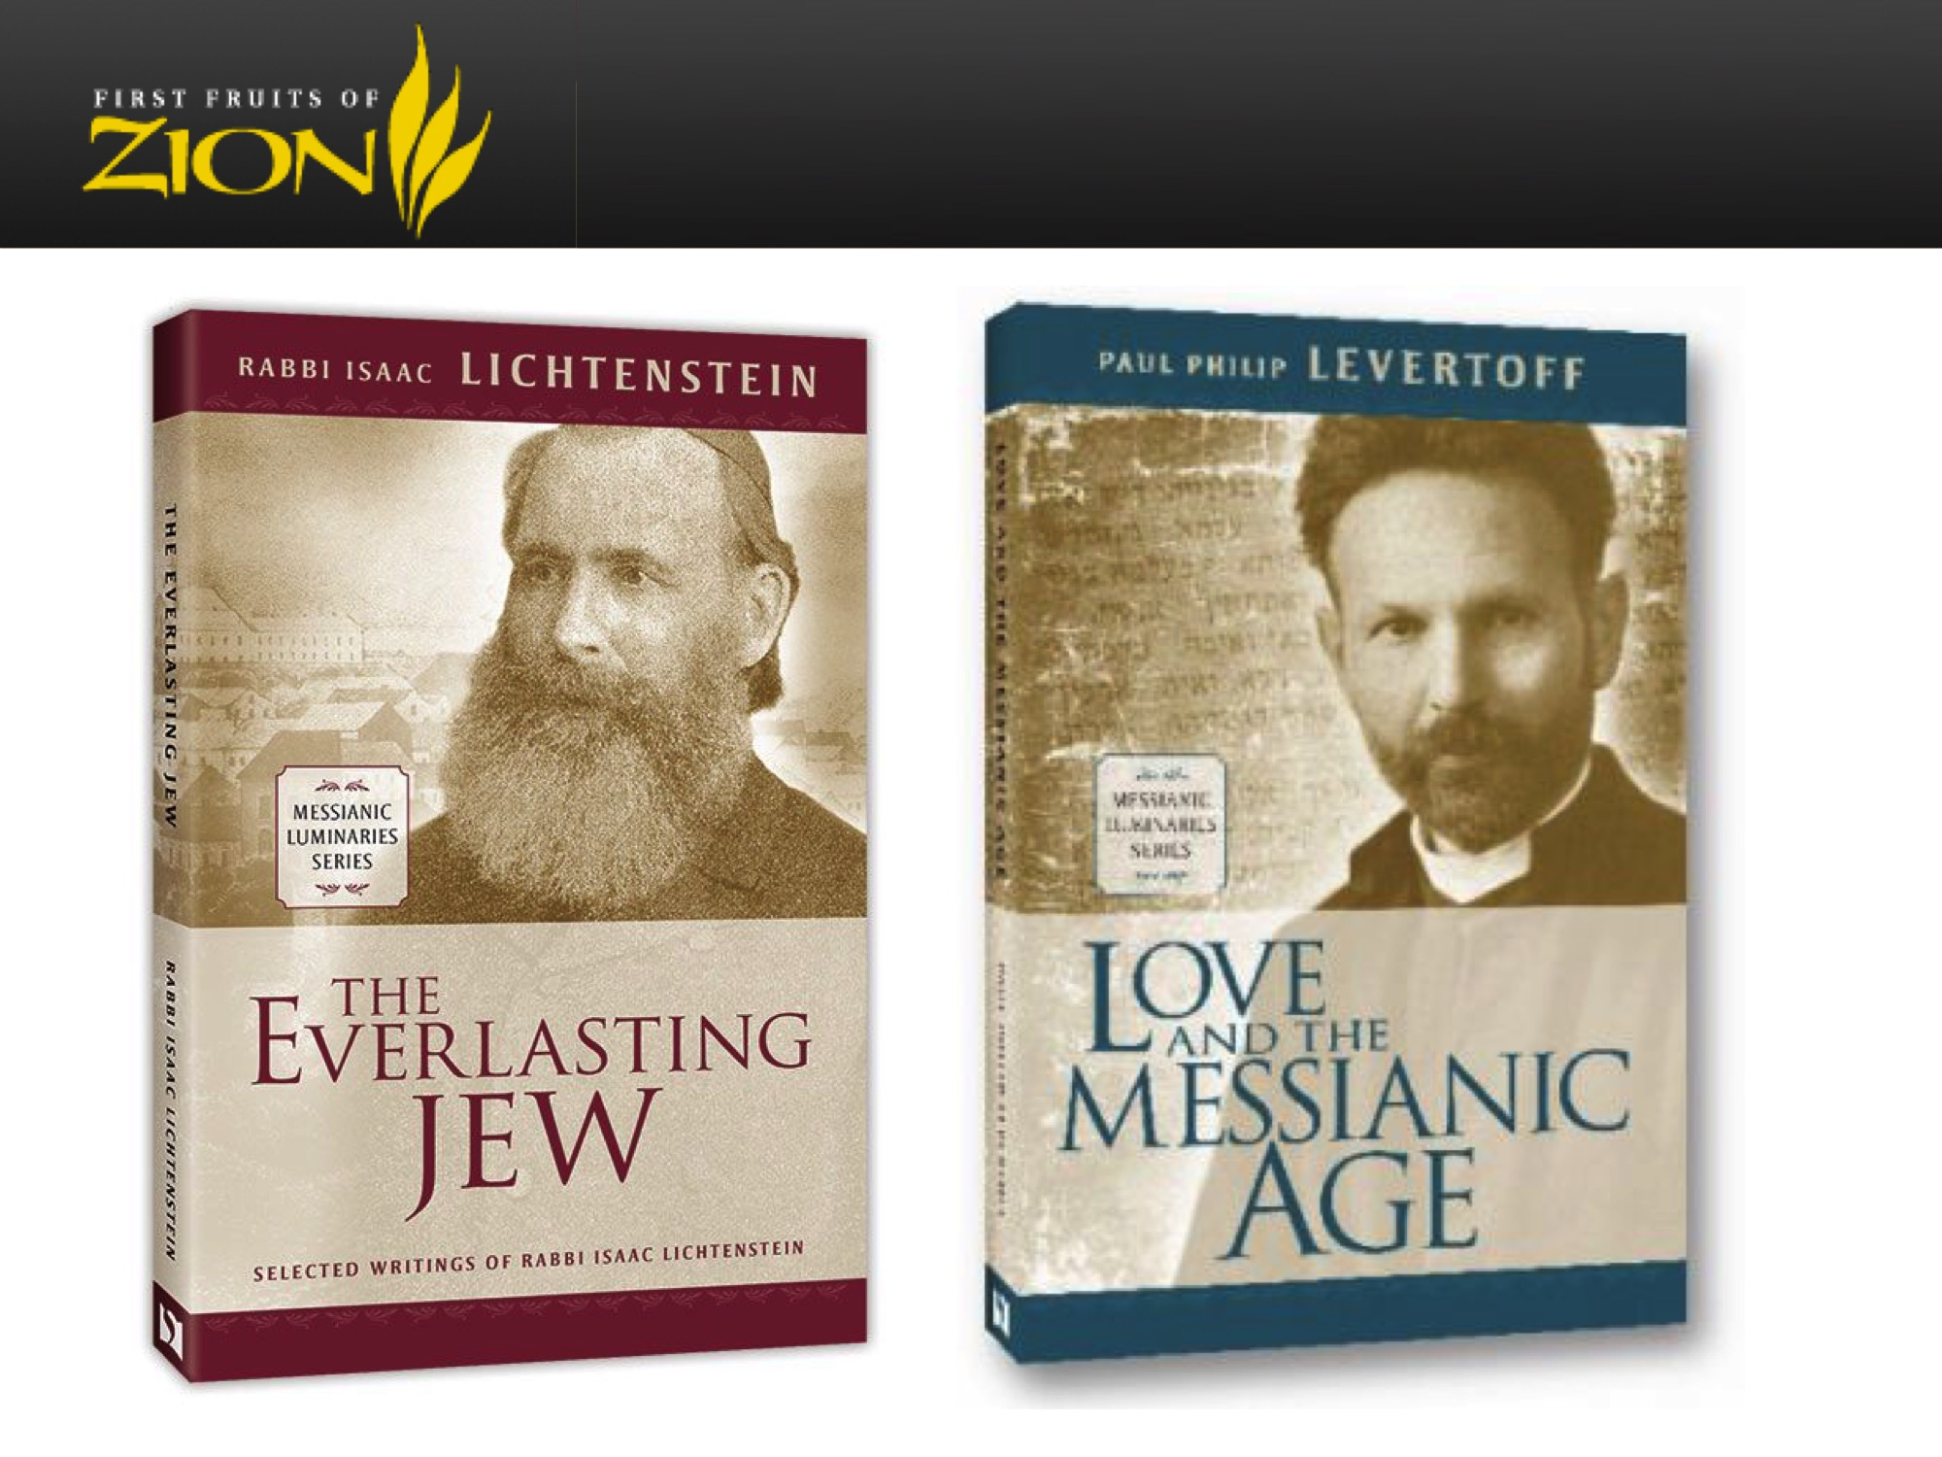
Notes:
The Everlasting Jew
Selected Writings of Rabbi Isaac Lichtenstein
Rabbi Lichtenstein became an outspoken disciple of Yeshua of Nazareth, but he remained in his post as district rabbi for several years. Despite pressure from rabbinic authorities, Jewish believers, and Christian leaders, he could not be compelled to renounce Judaism or his devotion to the Torah. Today, he is regarded as a pioneer of the Messianic Jewish movement.
The Everlasting Jew, compiled, edited, and revised by Jordan Gayle Levy and D. Thomas Lancaster, is a new collation of Lichtenstein’s inspiring writings, many of them culled from the libraries of Europe and translated to English for the first time. The Everlasting Jew also includes the story of Lichtenstein’s life and his encounter with the Gospel.
Love and the Messianic Age
A Chasidic discourse from one of the pioneers of Messianic Judaism, Paul Levertoff, crammed with stimulating thought and pervaded by real spiritual beauty. A mint of good things and solid learning. A magnificent, sturdy gold-embossed hard cover, and it would make a handsome and classic addition to any library.
This is an important book for Messianic Judaism and Christianity both. It opens a field of inquiry and reflection which encourages us to internalize the spiritual truths of theology and of our faith in Messiah and causes us to consider our relationship with God, our motivations for serving him, and how our interactions with God and Torah can be expressed in hearts of joy, acts of love, fervent prayer, and sincere repentance. Most importantly, Levertoff’s work demonstrates just how mysterious and wonderful the Gospel message actually is. This is a book about experiencing God and attaining the revelation of the Messianic Era in the here and now.

Slide 8
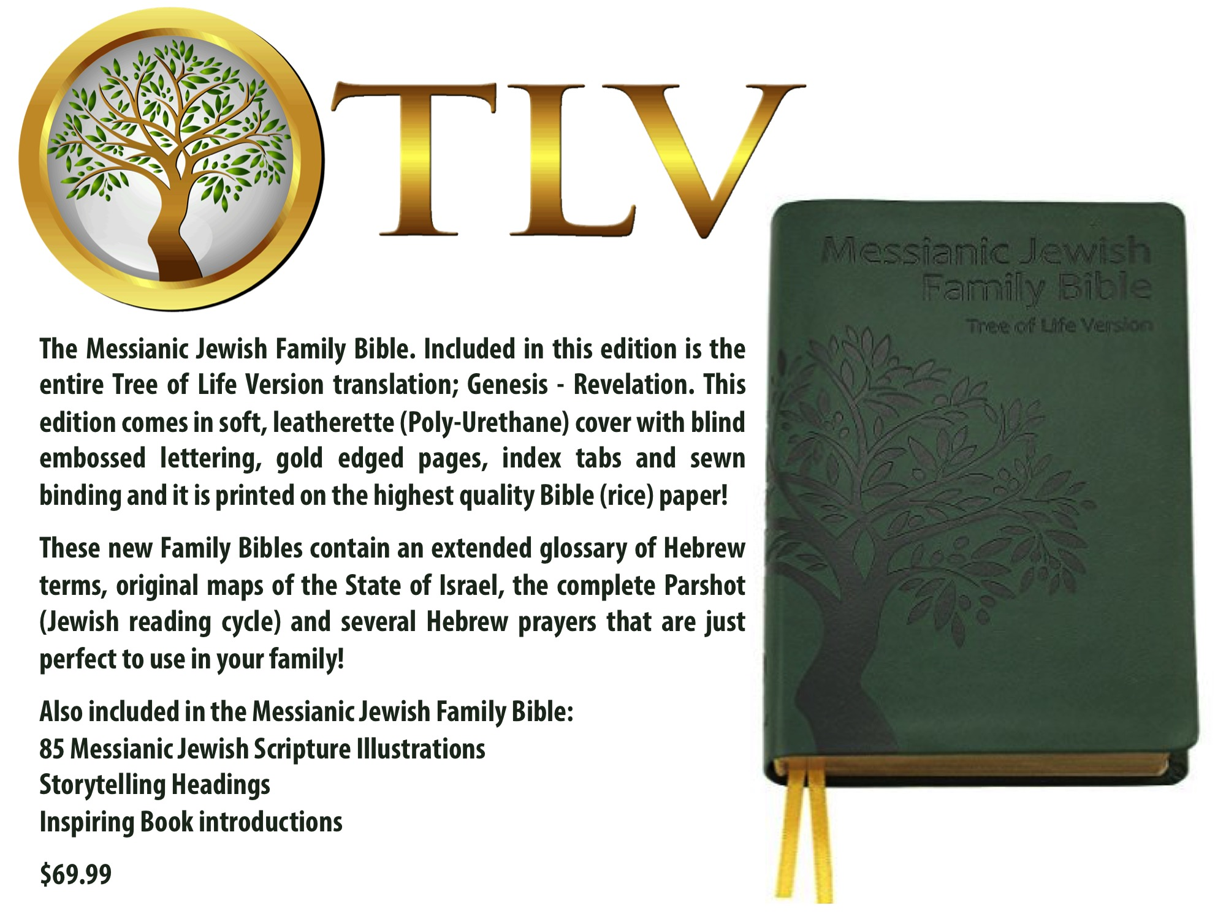
Notes:
The Messianic Jewish Family Bible.
Included in this edition is the entire Tree of Life Version translation; Genesis - Revelation. This edition comes in soft, leatherette (Poly-Urethane) cover with blind embossed lettering, gold edged pages, index tabs and sewn binding and it is printed on the highest quality Bible (rice) paper!
These new Family Bibles contain an extended glossary of Hebrew terms, original maps of the State of Israel, the complete Parshiot (Jewish reading cycle) and several Hebrew prayers that are just perfect to use in your family!
Also included in the Messianic Jewish Family Bible:
85 Messianic Jewish Scripture Illustrations
Storytelling Headings
Inspiring Book introductions

Slide 9
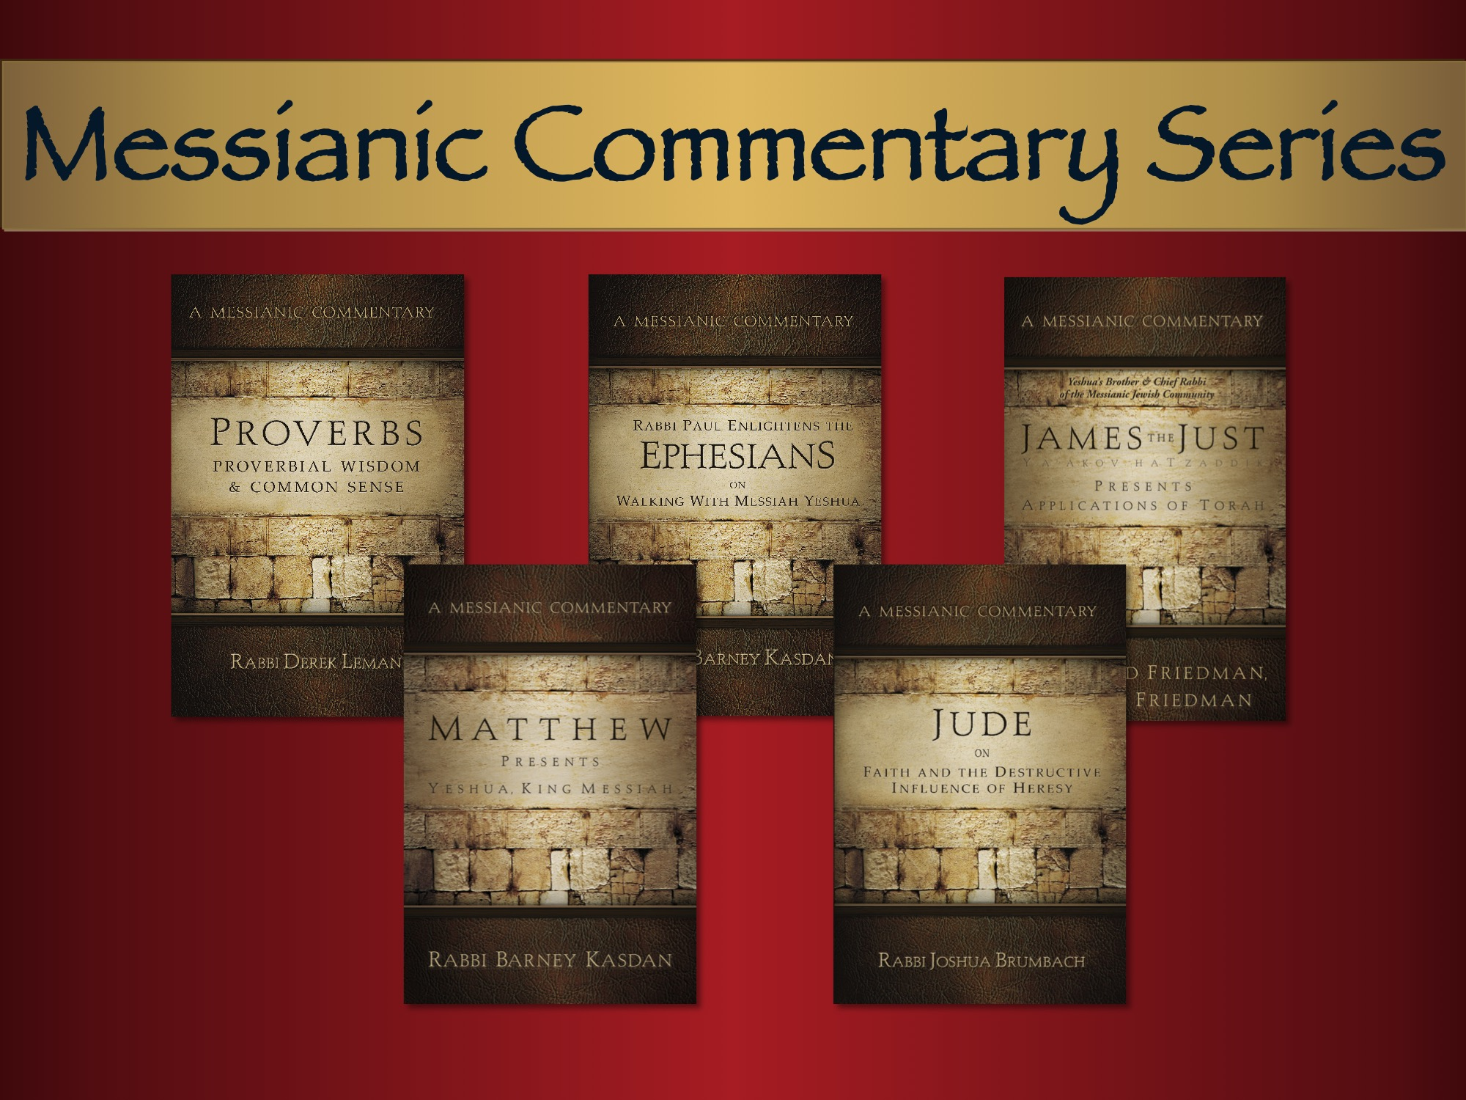
More in the Works!
Notes:
Proverbs - Proverbial Wisdom & Common Sense —Derek Leman
A Messianic Jewish Approach to Today’s Issues from the Proverbs
A devotional style commentary, divided into chapters suitable for daily reading.
An encyclopedia of practical advice on topics relevant to everyone. 248 pages
Matthew Presents Yeshua, King Messiah
A Messianic Commentary
—Rabbi Barney Kasdan
This commentator is well versed with first-century Jewish practices and thought,
as well as the historical and cultural setting of the day, and the ‘traditions of the
Elders’ that Yeshua so often spoke about. Get to know Yeshua, the King, through
the writing of another rabbi, Barney Kasdan. 448 pages.
Rabbi Paul Enlightens the Ephesians on Walking with Messiah Yeshua
A Messianic Commentary —Rabbi Barney Kasdan
The Ephesian were a diverse group of Jews and Gentiles, united together in Messiah. They definitely had an impact on the first century world in which they lived. But the Rabbi was not just writing to that local group. What is Paul saying to us? 160 pages.
Jude On Faith and the Destructive Influence of Heresy
A Messianic Commentary
—Rabbi Joshua Brumbach
Almost no other canonical book has been as neglected and overlooked as the Epistle of Jude. This little book may be small, but it has a big message that is even more relevant today as when it was originally written. 100 pages.
James the Just Presents Application of Torah
A Messianic Commentary
—Dr. David Friedman
James (Jacob) one of the Epistles written to first century Jewish followers of Yeshua. Dr. David Friedman, a former Professor of the Israel Bible Institute has shed new light for Christians from this very important letter. 152 pages.

Slide 10
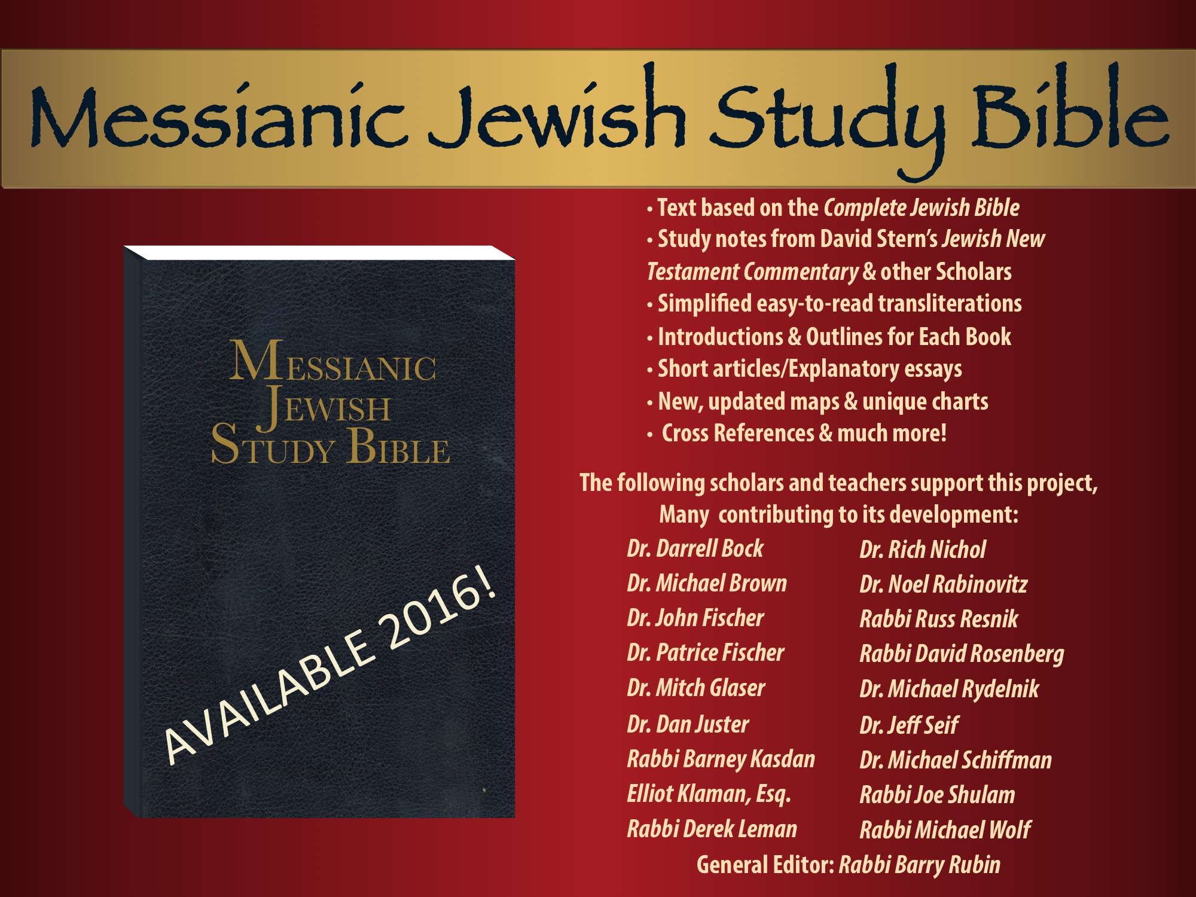
Notes:
Text based on the Complete Jewish Bible
Study notes from David Stern’s Jewish New
Testament Commentary & other Scholars
Simplified easy-to-read transliterations
Introductions and outlines for each book of the Bible
Short articles/Explanatory essays
New, updated maps & unique charts
Cross References & much more!

Slide 11
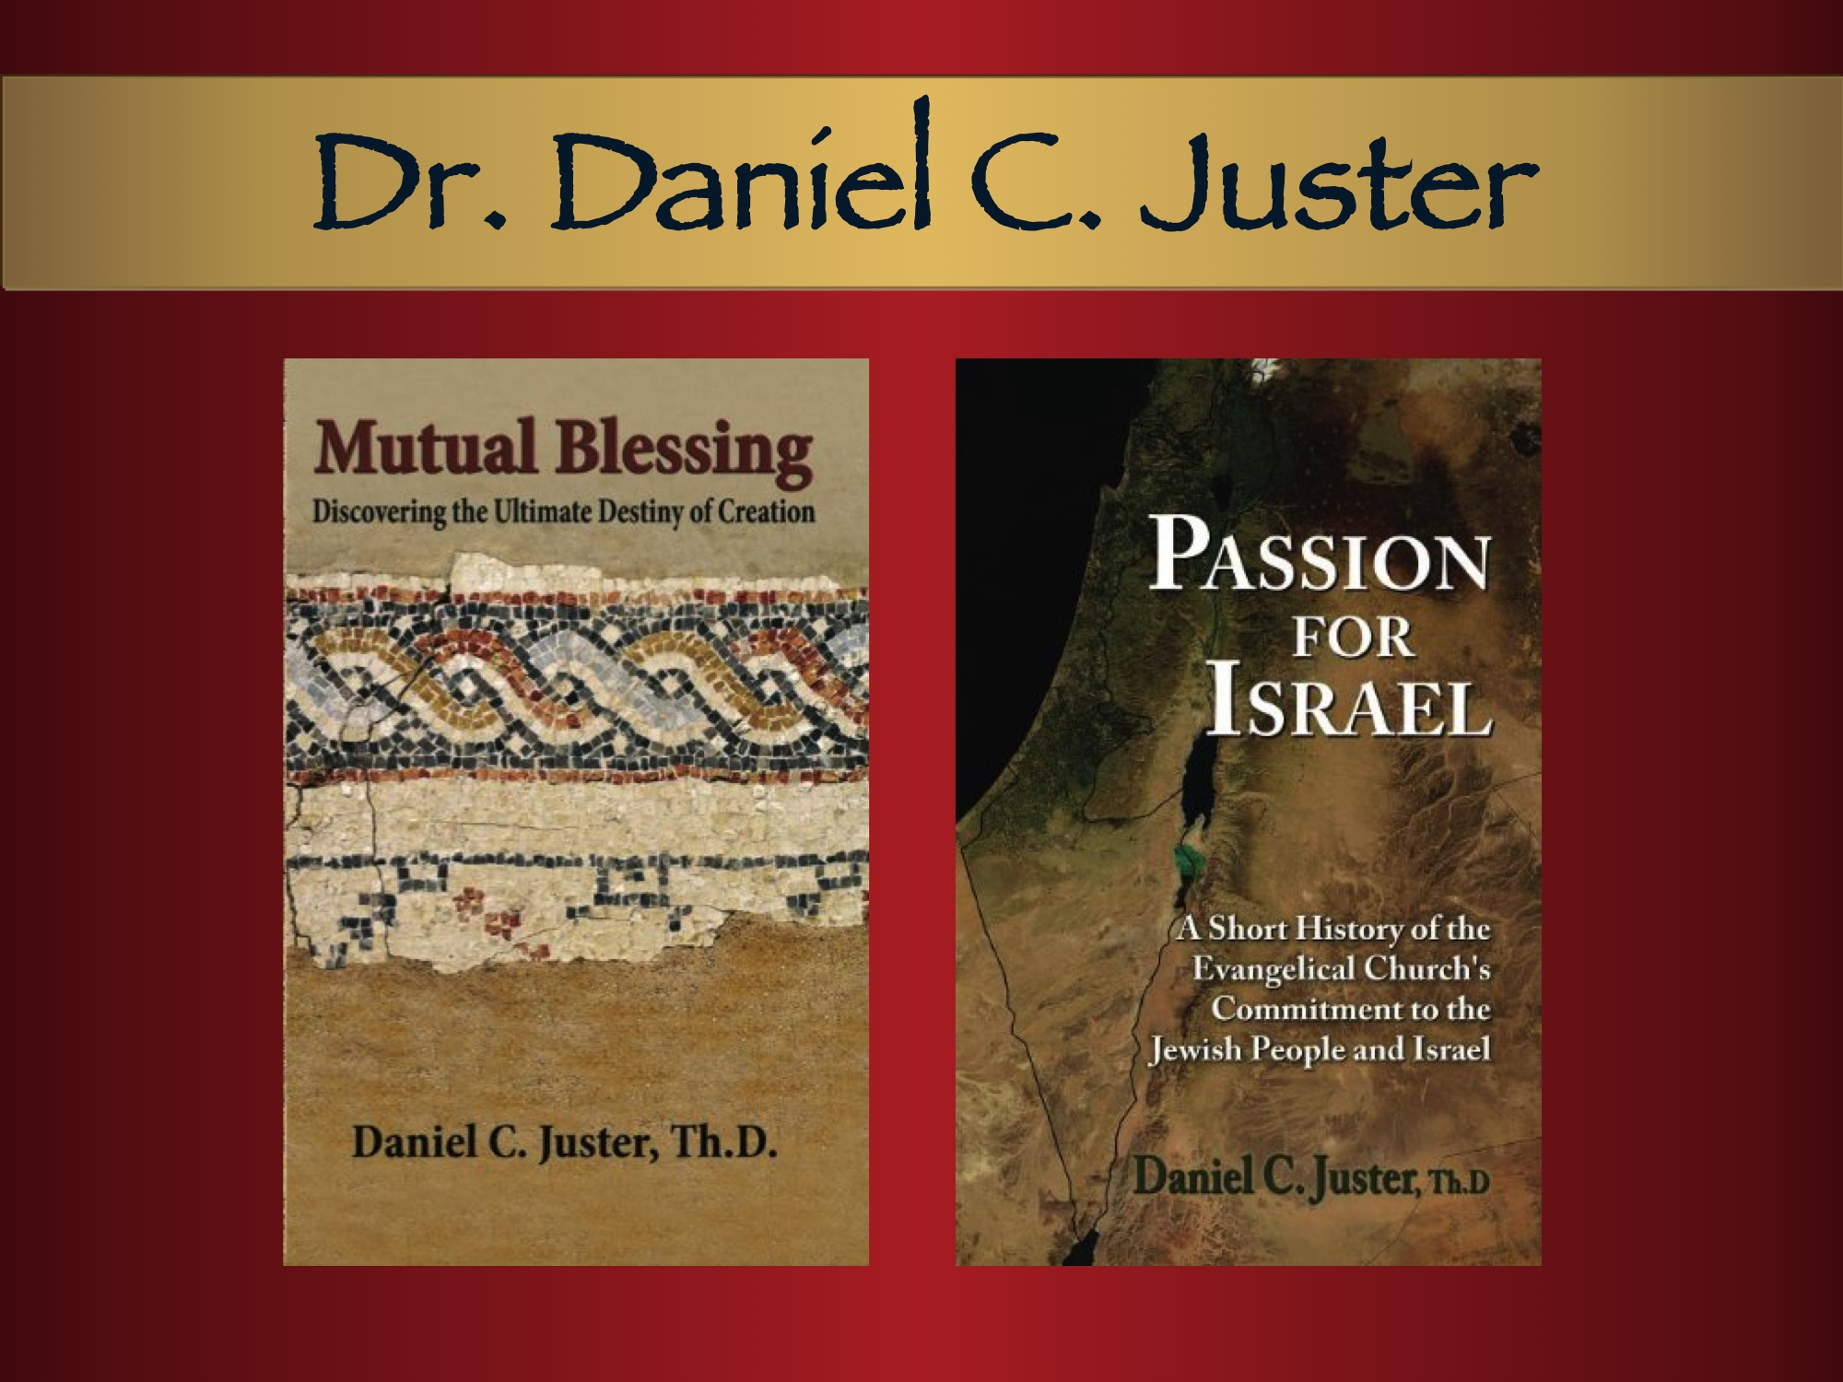
Notes:
Mutual Blessing
Discovering the Ultimate Destiny of Creation
—Dr. Daniel C. Juster
To truly love as God loves is to see the wonder and richness of the distinct differences in all of creation and his natural order of interdependence! 135 pages
Passion for Israel
A Short History of the Evangelical Church’s Support of Israel and the Jewish People
—Dr. Dan Juster
History reveals a special commitment of Christians to the Jews as God’s still elect people, but the terrible atrocities committed against the Jews by so-called Christians have overshadowed the many good deeds that have been performed. This important history needs to be told to help heal the wounds and to inspire more Christians to stand together in support of Israel.

Slide 12
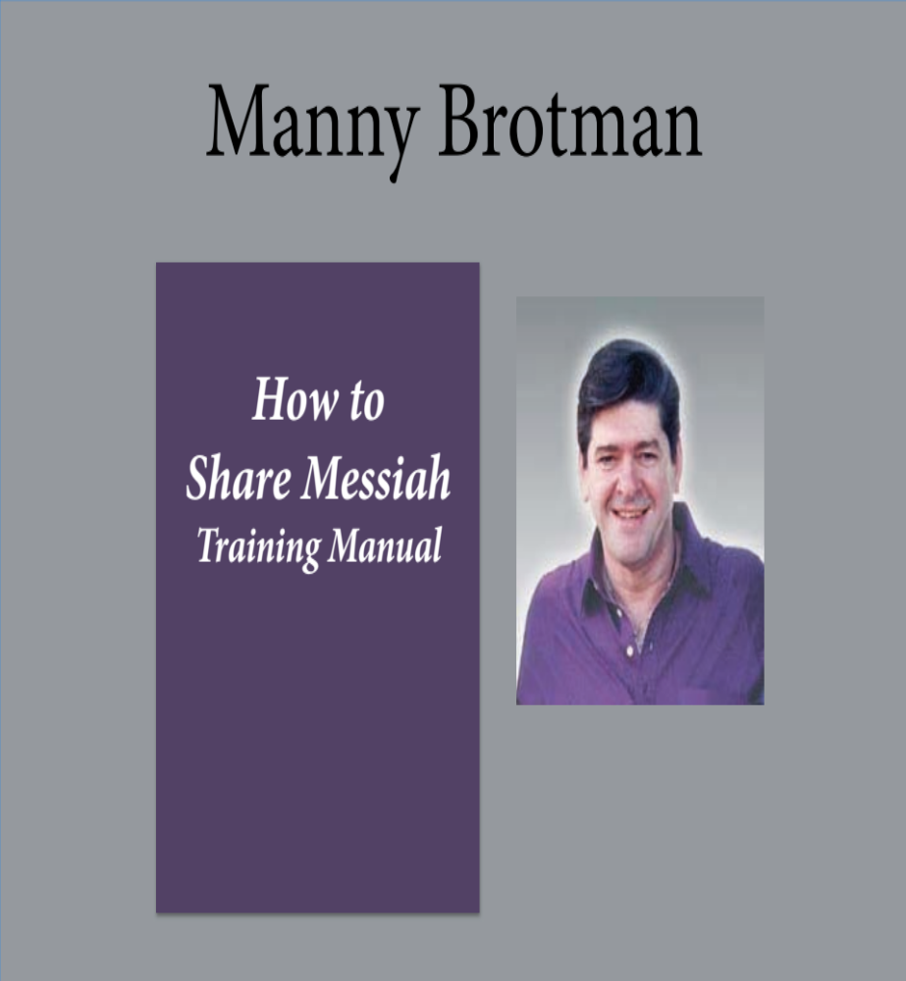
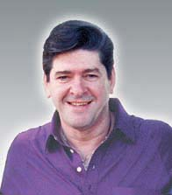
How to
Share Messiah Training Manual
The Jewish
Bible Approach
NEW! 6 cd set Audio Teaching by Manny Brotman
Notes:
From one of the pioneers of Messianic Judaism.
6 CDs of Manny's voice teaching the How to Share the Messiah course are being duplicated. How to Share the Messiah Training Manual by Messianic Jewish Rabbi Manny Brotman, and the advanced teaching, The Jewish Bible Approach and 6 CDs are available from Sandra Sheskin Brotman Ministries, 11500 Rokeby Avenue, Kensington, MD 20895-1024. Office no. 301/946-3999

Slide 13
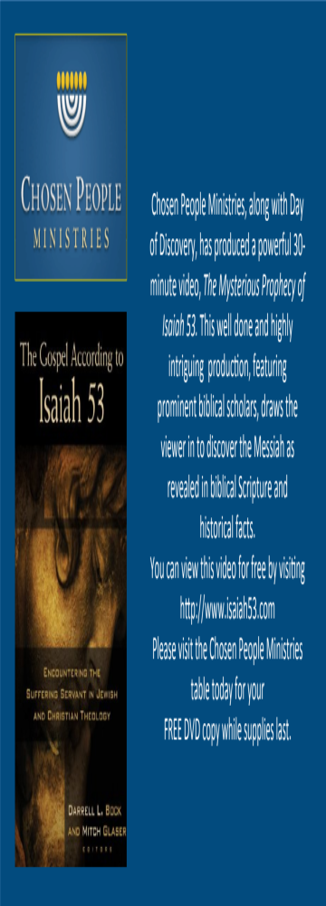
In the spring of 2014, Chosen People Ministries initiated a new branch of the Isaiah 53 Campaign in Israel. By translating the Isaiah 53 Explained book into Hebrew and launching a corresponding website also in Hebrew, we have been able to offer this book for free to an audience that is desperately seeking the truth that can only be found in our Messiah Yeshua (Jesus). The evangelistic book, Isaiah 53 Explained, has been translated into and distributed amongst English, Spanish, and now Hebrew-speaking audiences.
Notes:
In the spring of 2014, Chosen People Ministries initiated a new branch of the Isaiah 53 Campaign in Israel. By translating the Isaiah 53 Explained book into Hebrew and launching a corresponding website also in Hebrew, we have been able to offer this book for free to an audience that is desperately seeking the truth that can only be found in our Messiah Yeshua (Jesus). The evangelistic book, Isaiah 53 Explained, has been translated into and distributed amongst English, Spanish, and now Hebrew-speaking audiences.
Isaiah 53 Explained deals with a pivotal passage in the Jewish Bible that has the power to change lives in Jewish communities around the world. As readers journey through the chapter of Isaiah 53, they examine the historical trustworthiness of the Scriptures, meet the God who predicts the future and also brings it to pass, and discover the most soul-satisfying relationship in the world.
The next languages we plan to introduce in the campaign in are: Russian, Farsi, French and Dutch.

Slide 14
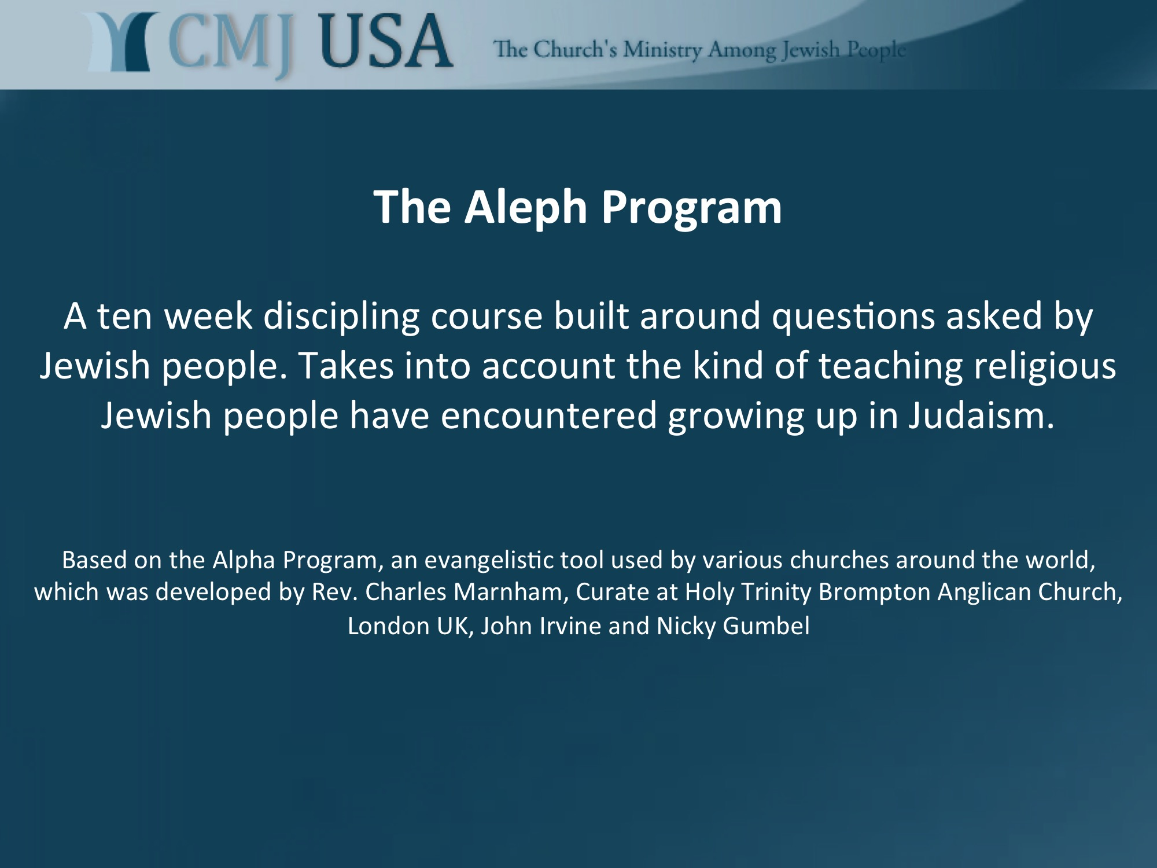
Notes:
http://www.cmj-usa.org
For nearly forty years the Alpha program has been an effective evangelistic tool now used by various churches around the world. The Aleph program is designed with the strengths of the Alpha program in mind, largely following its format. It’s content, however, is built around questions asked by Jewish people.

Slide 15
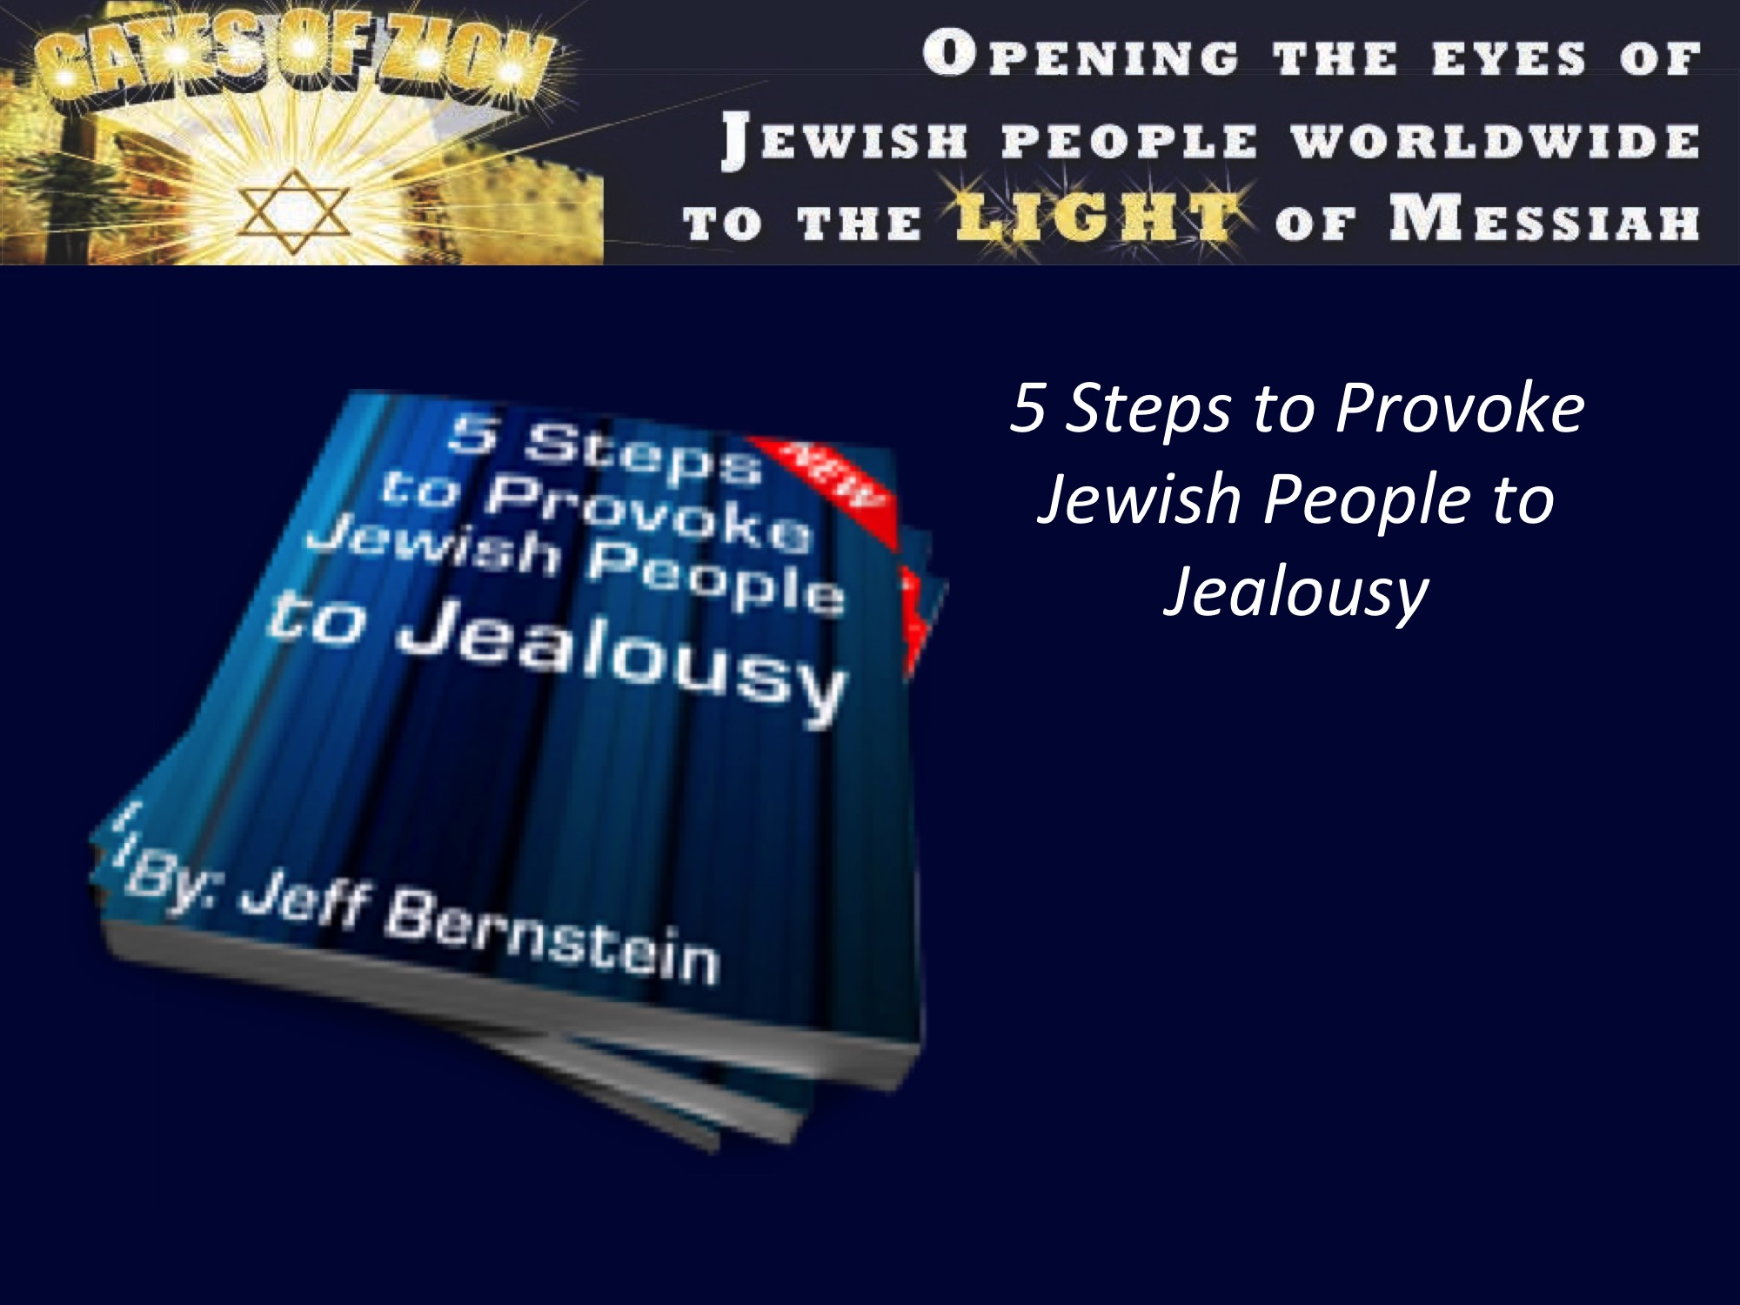
Notes:
Gates of Zion, Jeff Bernstein
www.gatesofzion.net
5 Steps to Provoke Jewish People to Jealousy
This little pamphlet is good to help Christians learn how to fulfill their “great commission,” “to provoke Jews to jealousy” for the Messiah.

Slide 16
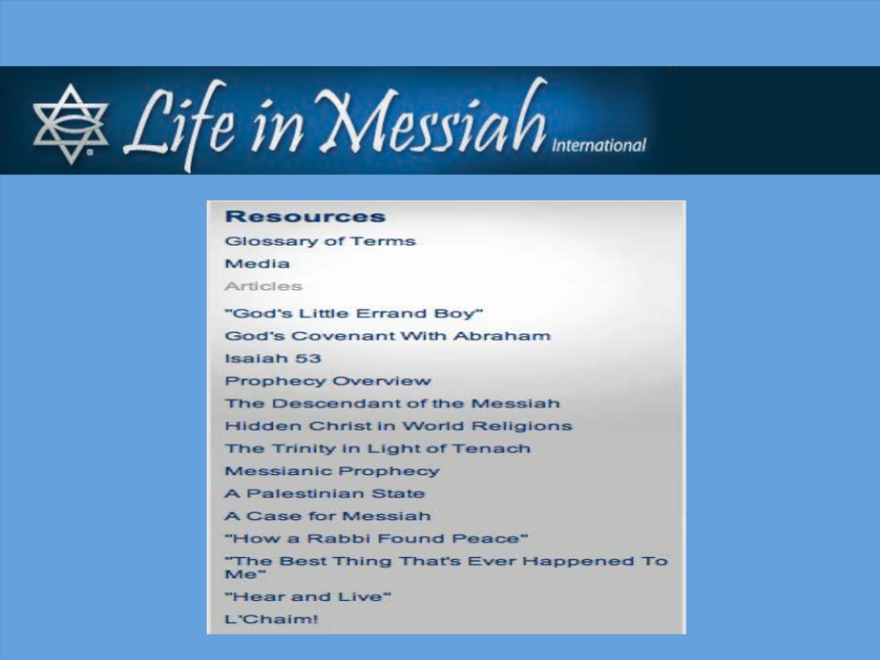
Notes:
www.lifeinmessiah.org

Slide 17

Notes:
Promised Land: Israel Through The Eyes of Surfers
www.promisedlandthemovie.com
“Surfer film producers doing more for the cause of peace in the Middle East than decades of political wrangling and cross-border missiles” KUSI San Diego news anchor Tom Jordan
In the most unsuspecting place, two friends, each from the other side of the world, find a common ground, a shared passion—surf. Hani, an Israeli born surfer and board shaper, met Todd Morehead, an American born surfer, in the waters off the Israeli coast. Hani, after seeing Todd surf, introduced himself and a friendship was born. Though separated by thousands of miles and each having a different faith, the two men have a deep friendship that exceeds all boundaries. In this world, where headlines scream about wars in the Middle East, bombings in Israel, and unease throughout that land, Promised Land shows that peace can exist in one arena. Surfing in Israel can bring Jews, Arabs, and Christians together. Promised Land not only shows the beauty of the Israeli waves, her people, and the tension that exists between beliefs, it elevates the human spirit. Featuring surf champions Maya Dauber, Oran Weiss and Tom Curren, the viewer is drawn over country and religious lines into a love for one of the most powerful forces on earth-water, which yields the beautiful and healing sport of surf.

Slide 18

Notes:
The Sound of the Spirit - DVD
Beautiful and precocious Rivka is a twelve-year-old Jewish girl who believes in Jesus. She and her father attend a Messianic Jewish congregation in their community. But when her father suddenly dies, Rivka's life changes forever. She ends up moving in with her traditional Jewish relatives and attending their synagogue. From her stormy relationship with her uncle, to a meeting with the synagogue's senior rabbi, to the attention of the cutest boy in the synagogue, Rivka learns life lessons that stir her faith to new levels, touching the hearts of those whose lives she has reluctantly impacted. "The Sound of the Spirit" is the never-before-told story of a young girl caught in the crossfire of strong feelings between two faith communities. It's told with humor, compassion, and grace.
ASIN: B008C3ARG4 $13.95

Slide 19
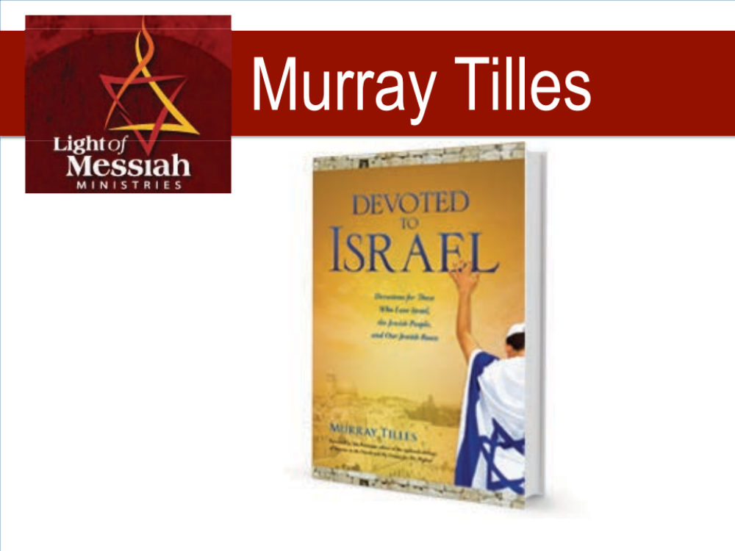
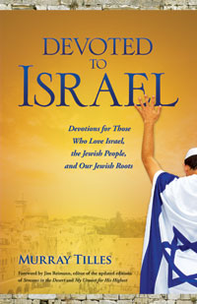
Notes:
Devoted to Israel
Devotions for Those Who Love Israel, the Jewish People, and Our Jewish Roots
A Book by Murray Tilles (160 pages)
In his book, "Devoted To Israel," Murray Tilles, through 70 insightful devotions and moving prayers, will help you to connect with Israel and the Jewish people. He will encourage you to understand our faith through Jewish eyes. Devoted to Israel will enable you not only better understand the land of Israel, the Jewish people and our Jewish roots, but actually fulfill God's command to "Pray for the peace of Jerusalem." (Psalm 122:6)

Slide 20
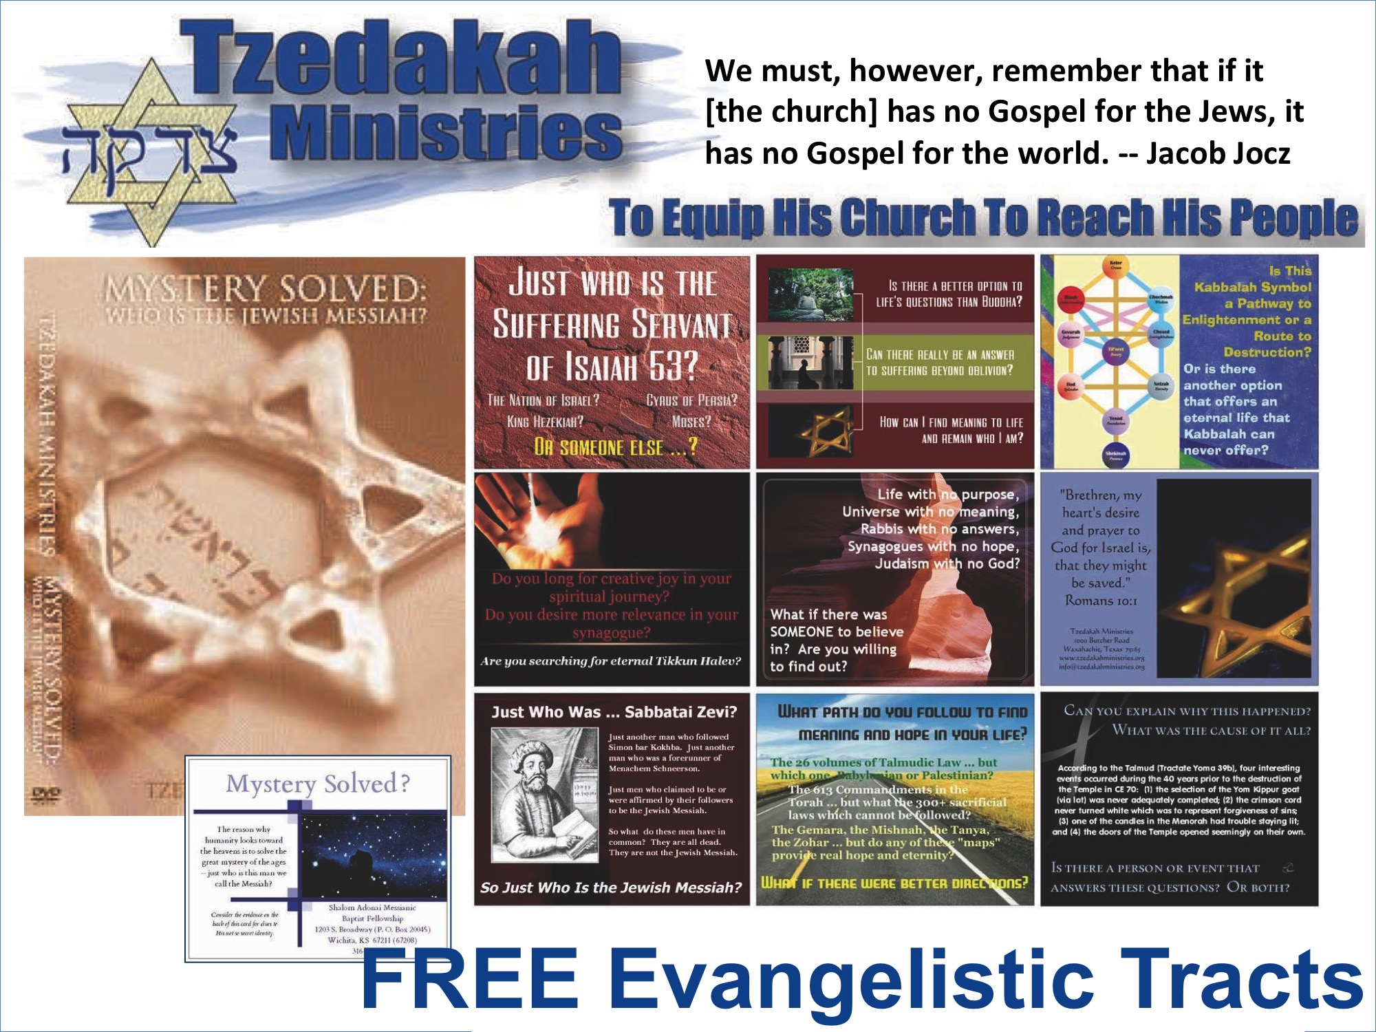
Notes:
http://tzedakahministries.org
Tzedakah Resources
(1) All evangelistic tracts and the evangelistic DVD are free.
(2) The evangelistic tracts are available in German. Limited versions of the tracts are available in Spanish and Portuguese.

Slide 21
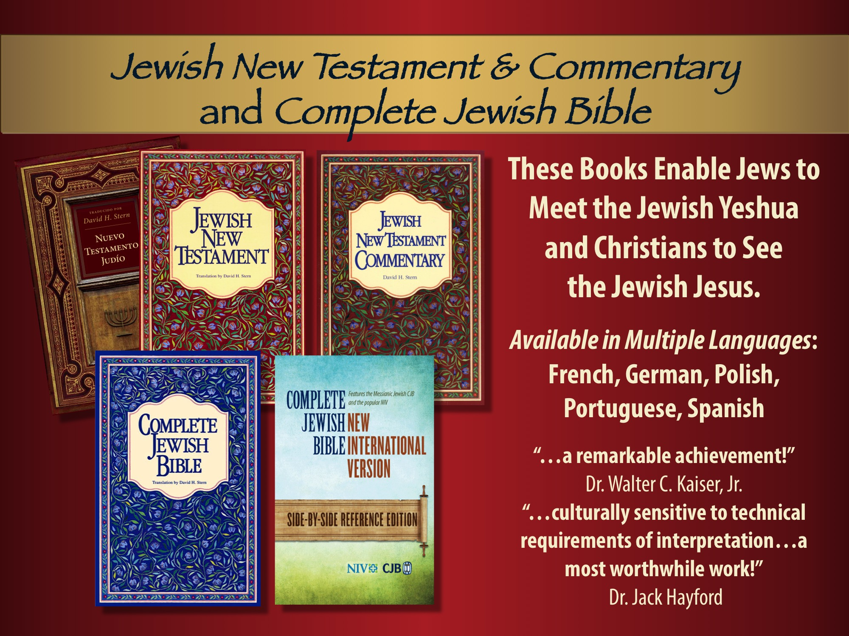
Notes:
Jewish New Testament —Translated by Dr. David H. Stern
The New Testament is a Jewish book, written by Jews, initially for Jews. Its central
figure was a Jew. His followers were all Jews. This version communicates its
original, essential Jewishness. Highlights Jewish references. Freshly translated into English from Greek. 436 pages
Jewish New Testament Commentary —Dr. David H. Stern
This companion volume to the New Testament of the Complete Jewish Bible
enhances Bible study. Passages and expressions are explained in their original
cultural context, the way 1st century Jewish writers meant for them to be
understood! Over fifteen years of research and study went into the JNTC to make
the New Testament more meaningful! 960 pages.
Complete Jewish Bible: A New English Version —Dr. David H. Stern
Presenting the Word of God as a unified Jewish book, a new version for Jews and non-Jews alike; to connect Jews with the Jewishness of the Messiah, and non-Jews with their Jewish roots.
Names and terms are returned to their original Hebrew and presented in easy-to-understand transliterations, enabling the reader to say them the way Yeshua (Jesus) did! 1697 pages. Available in paperback, hardcover, leather and large size.

Slide 22
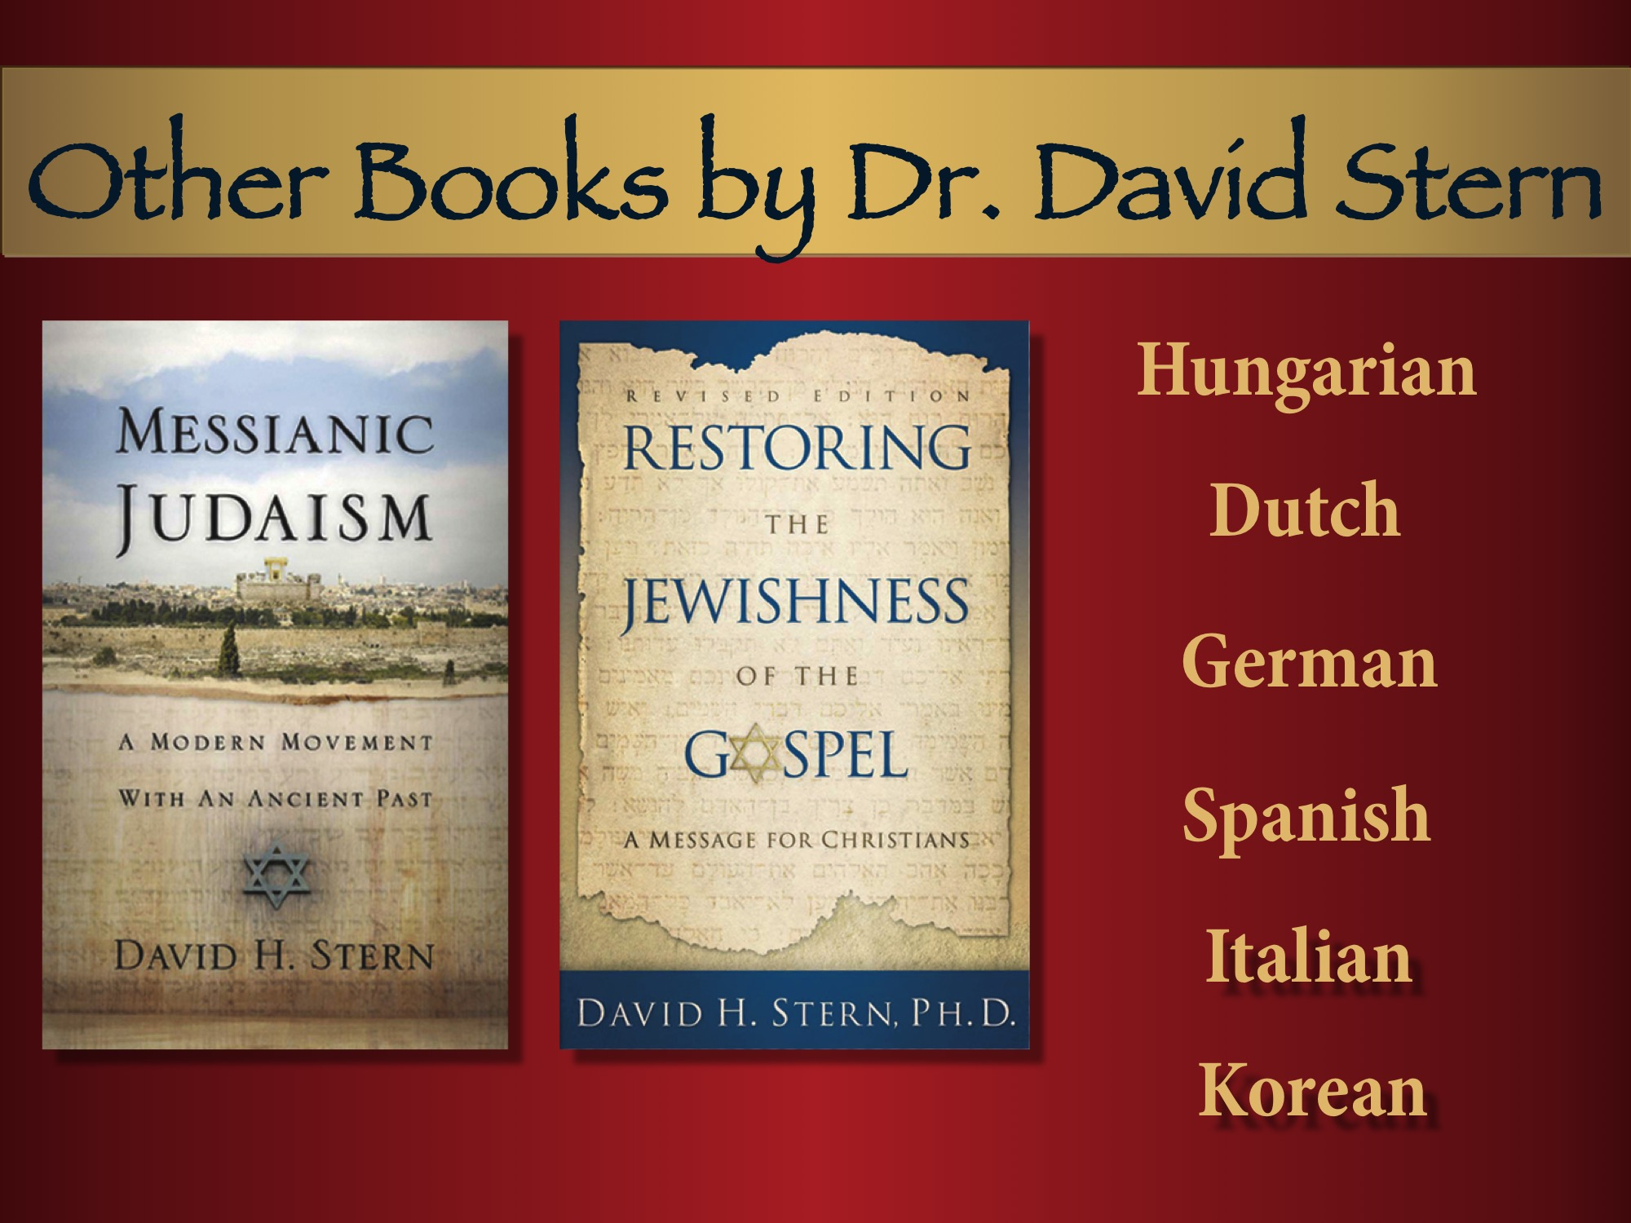
Notes:
Messianic Judaism
A Modern Movement With an Ancient Past
—David H. Stern
An updated discussion of the history, ideology, theology, and program for
Messianic Judaism. A challenge to both Jews and non-Jews who honor Yeshua.
Restoring the Jewishness of the Gospel
A Message for Christians
—David H. Stern
A book the whole Church needs to read! A challenge to conventional Christian ideas!
Clear thinking about neglected questions such as:
- What central truth, ignored for 1800 years, must be restored if the Church is to fulfill
the Great Commission?
- How are both the Jews and the Church God's people?
- Is there a difference between Jew and Gentile in the body of the Messiah?
- Will God fulfill all of his promises to Israel?
- Does the Law of Moses remain in force today?
- Should the Church evangelize Jews today? If so, how?
An insightful book by an Israeli Messianic Jew who trusts Yeshua (Jesus). 110 pages.

Slide 23
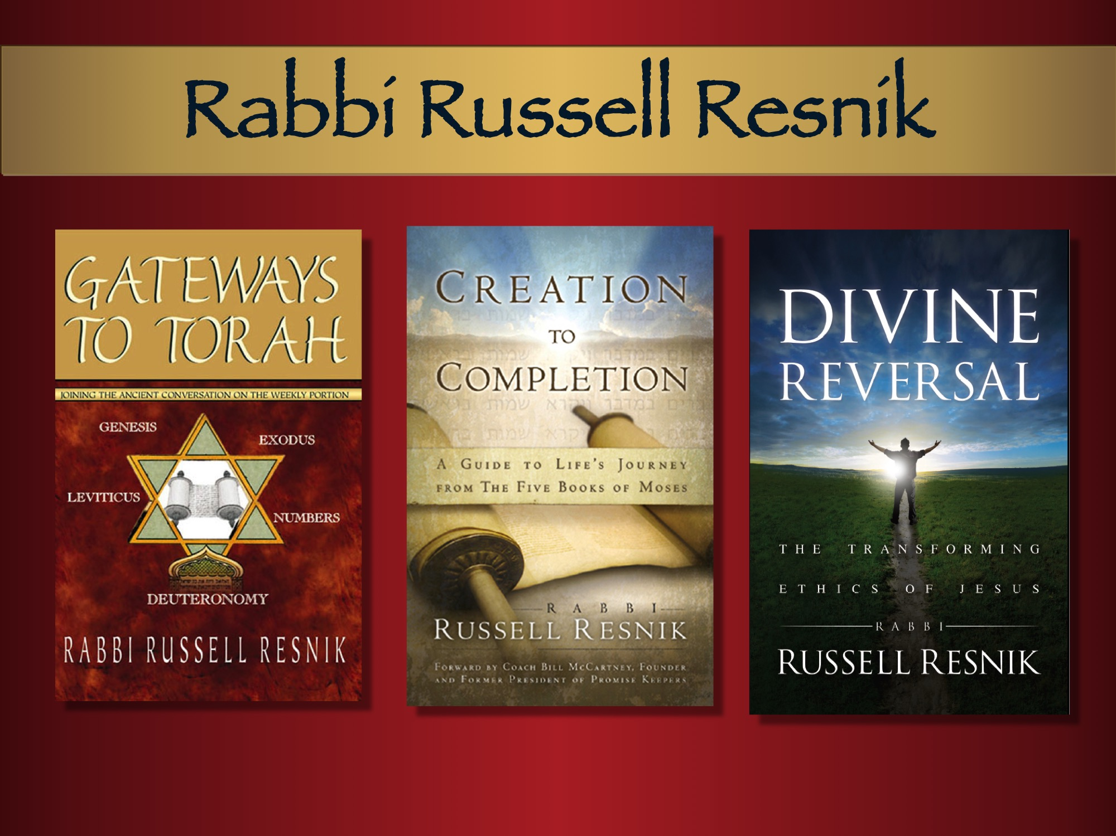
Notes:
Gateways to Torah Joining the Ancient Conversation on the Weekly Portion —Rabbi Russell Resnik
From before the days of Messiah until today, Jewish people have read from and discussed a prescribed portion of the Pentateuch each week. Now, a Messianic Jewish Rabbi, Russell Resnik, brings another perspective on the Torah, that of a Messianic Jew. 246 pages.
Paperback
Creation to Completion A Guide to Life’s Journey from the Five Books of Moses —Rabbi Russell Resnik
Endorsed by Coach Bill McCartney, Founder of Promise Keepers & Road to Jerusalem: Paul urged Timothy to study the Scriptures (2 Tim. 3:16), advising him to apply its teachings to all aspects of his life. Since there was no New Testament then, this rabbi/apostle knew that his disciple would profit from studying the Torah, the Five Books of Moses, and the Old Testament. 256 pages.
Paperback
Divine Reversal
The Transforming Ethics of Jesus
—Rabbi Russell Resnik
In the Old Testament, God often reversed the plans of man. Yeshua’s ethics continue this theme. Following his path transforms one’s life from within, revealing the source of true happiness, forgiveness, reconciliation, fidelity and love. 206 pages
Paperback

Slide 24
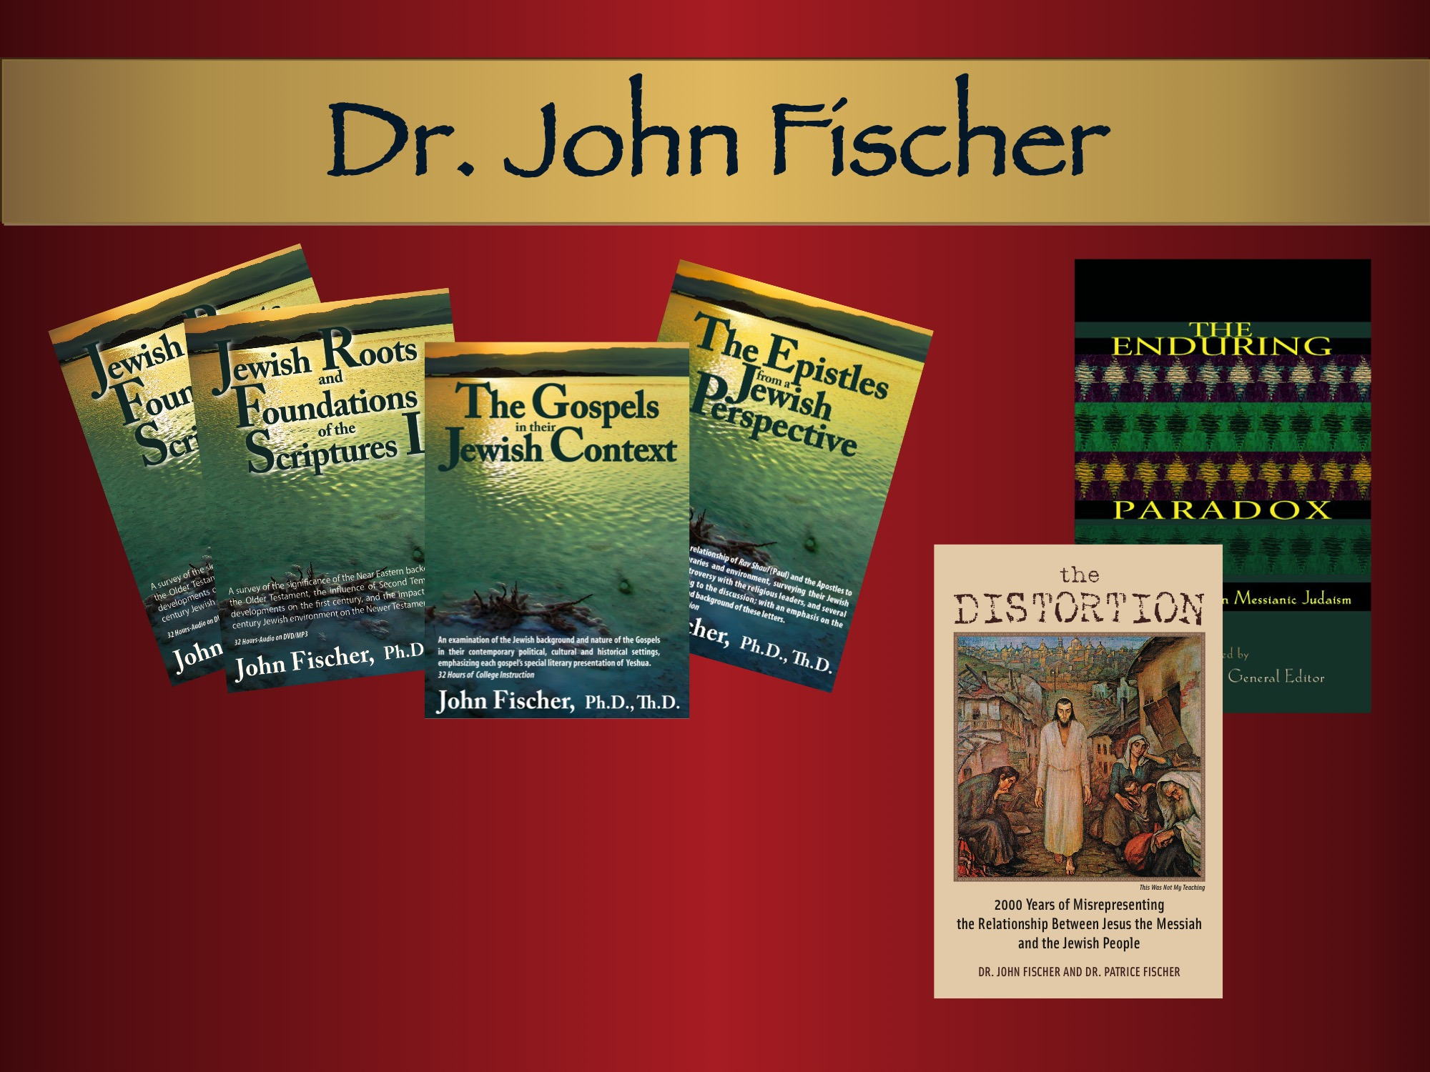
Notes:
Jewish Roots and Foundations of the Scriptures I & II
—John Fischer, Th.D, Ph.D.
As in a painting, the background is the panorama of preparation and pictures found in the Old Testament. In the foreground is the landscape and light of the first century Jewish setting. All of this is intricately connected with and highlights the subject—which becomes the flowering of all these aspects—the coming of God to earth and what that means for us. Each audio is 32 hours of live class.
The Gospels in their Jewish Context
—John Fischer, Th.D, Ph.D.
An examination of the Jewish background and nature of the Gospels in their contemporary political, cultural and historical settings, emphasizing each gospel’s special literary presentation of Yeshua, and highlighting the cultural and religious contexts necessary for understanding each of the gospels. 32 hours of audio/video instruction on MP3-DVD and pdf of syllabus.
The Epistles from a Jewish Perspective
—John Fischer, Th.D, Ph.D.
An examination of the relationship of Rabbi Shaul (the Apostle Paul) and the Apostles to their Jewish contemporaries and environment; surveys their Jewish practices, teaching, controversy with the religious leaders, and many critical passages, with emphasis on the Jewish nature, content, and background of these letters. 32 hours of audio/video instruction on MP3- DVD and pdf of syllabus.
The Distortion 2000 Years of Misrepresenting the Relationship Between Jesus the Messiah and the Jewish People
—Dr. John Fischer & Dr. Patrice Fischer
Did the Jews kill Jesus? Did they really reject him? With the rise of global anti–Semitism, it is important to understand what the Gospels teach about the relationship between Jewish people and their Messiah. 2000 years of distortion have made this difficult. 126 pages. (Art Poster Available: This Was Not My Teaching)
The Enduring Paradox
Exploratory Essays in Messianic Judaism
— General Editor Dr. John Fischer
Yeshua and his Jewish followers began a new movement—Messianic Judaism—2,000 years ago. In the 20th century, it was reborn and is currently maturing. Twelve essays from top contributors to the theology of this vital movement of God, including: Dr. Walter C. Kaiser, Dr. David H. Stern, and Dr. John Fischer. 196 pages..

Slide 25
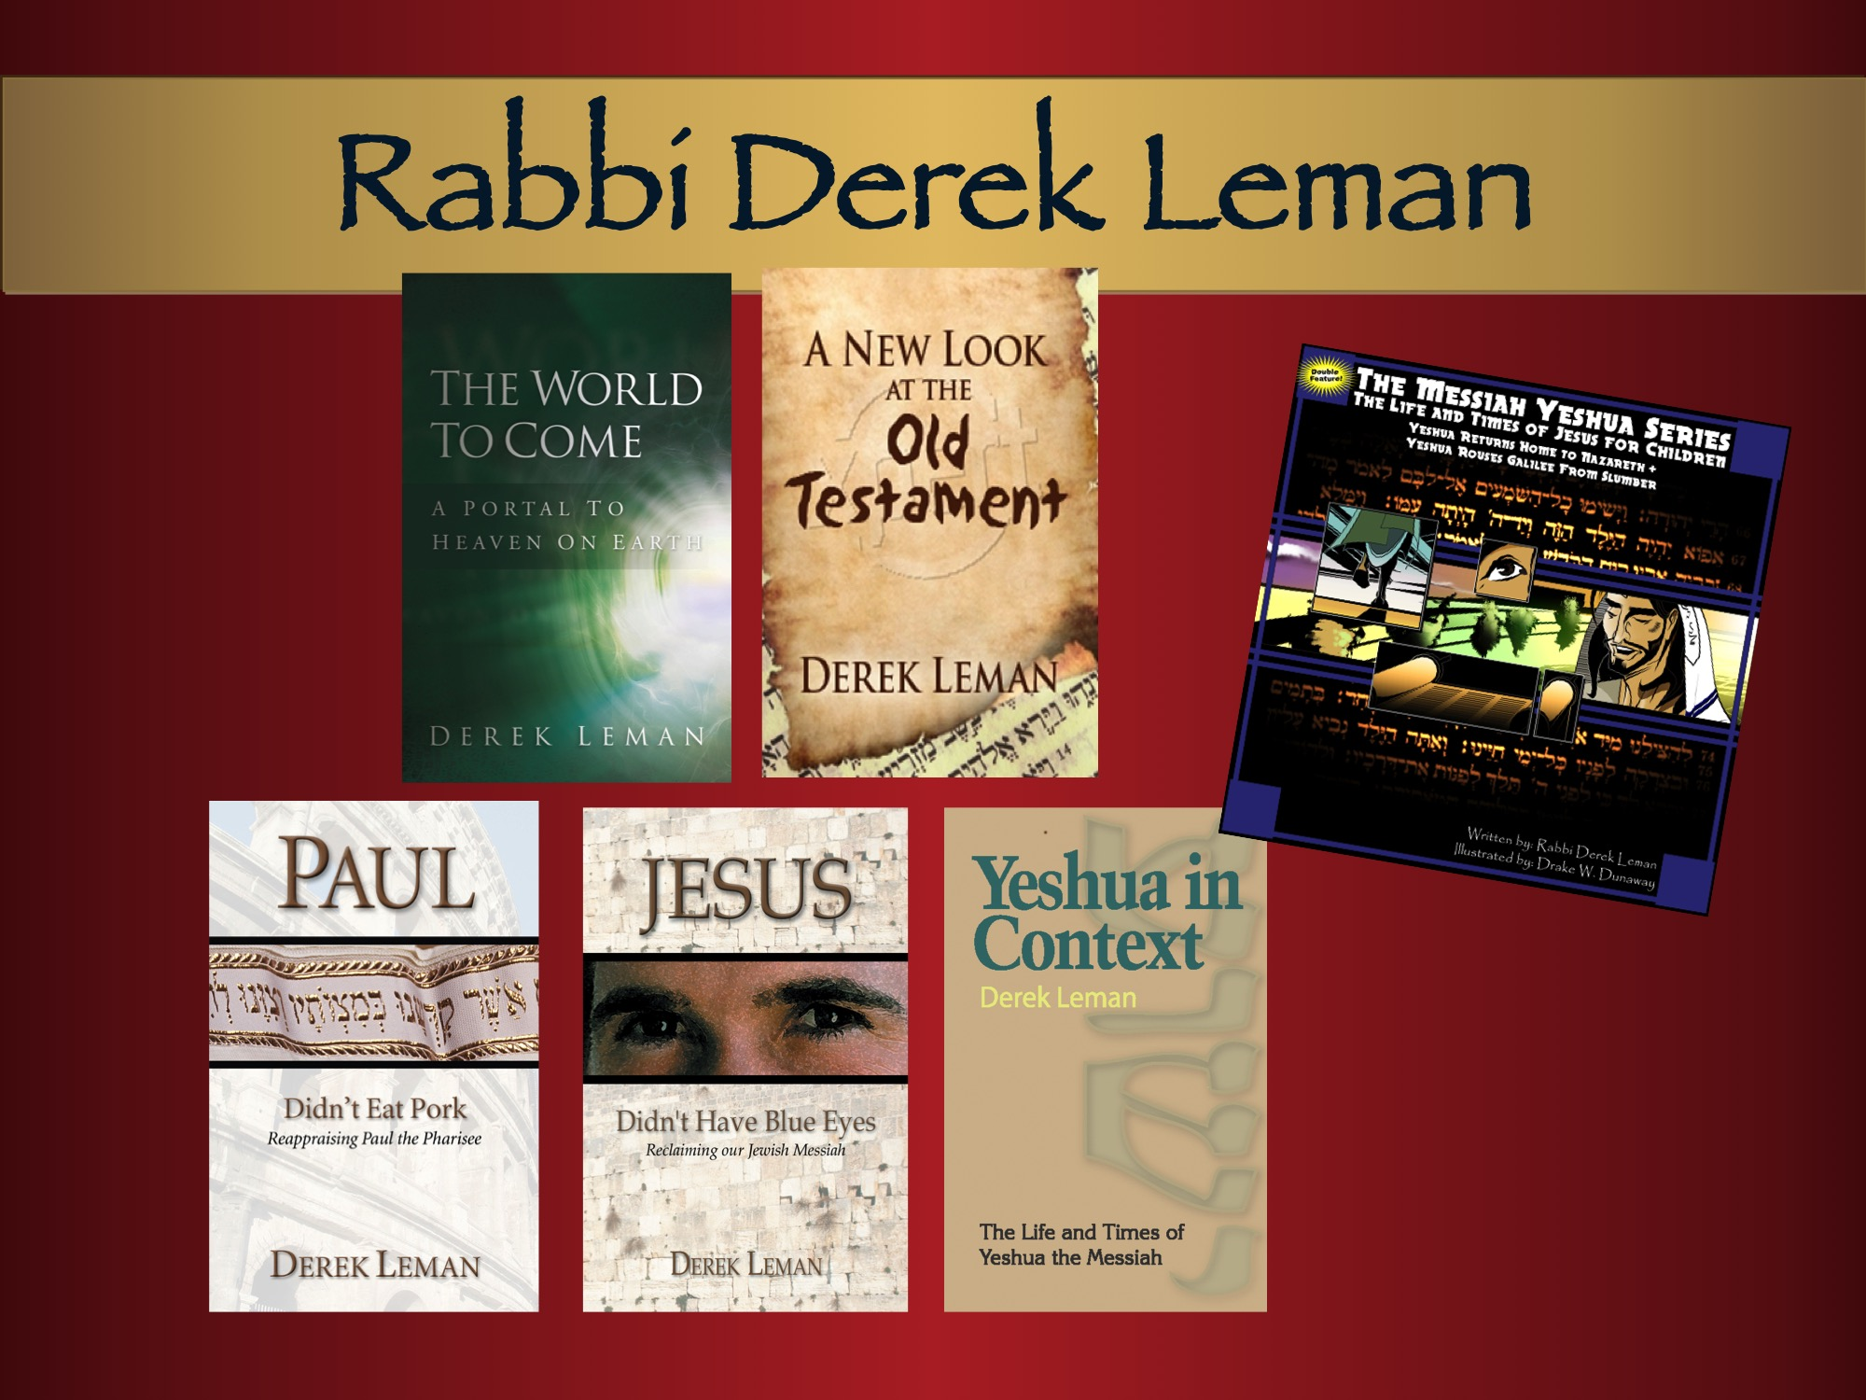
Notes:
The World To Come A Portal to Heaven on Earth —Derek Leman
An insightful book, exposing fallacies and false teachings surrounding this extremely important subject... paints a hopeful picture of the future and dispels many non-biblical notions. Offers a fresh, but old, perspective on the world to come, as it interacts with the prophets of Israel and the Bible. 110 pages. Paperback
A New Look At The Old Testament
– Derek Leman
In his latest book, Rabbi Derek Leman dispels certain myths about the Old Testament, such as—it is not as relevant as the New Testament, it is boring and difficult to understand, God is usually mad in the Old Testament and it lacks grace. This book will help readers see that the Old Testament is a book about a magnificent and indescribably holy and gracious God. 168 pages.
Paperback
The Messiah Yeshua Series for Children, Vol. 1
The Life and Times of Jesus for Children
—Rabbi Derek Leman, Illus. by Drake Dunaway
Imagine a series of children’s books on the life and teaching of Yeshua with art that properly portrays his Jewish context. Derek Leman writes the stories of Yeshua from the gospels with a keen sense of the Judaism of Yeshua’s time and the meaning of Messiah’s words and deeds for Israel and for the nations of the world. Illustrator Drake Dunaway captures the Jewish Messiah as he should be drawn so kids can see Yeshua and his disciples as Jewish men and women compelled by a vision of God’s kingdom and God’s king. 45 pages.
Paperback
Paul Didn’t Eat Pork
Reappraising Paul the Pharisee
– Derek Leman
A brief but information-packed exploration of the Jewish life and thought of Paul according to the New Testament. Paul remained a Pharisee his whole life, kept not only the Law of Moses but also the traditions of the Jewish people, and continued to offer sacrifices at the Temple. 114 pages.
Paperback
Jesus Didn’t Have Blue Eyes
Reclaiming Our Jewish Messiah
– Derek Leman
Jesus did not come to start a new religion, nor to take us away from Judaism, but instead to take Judaism to the next level. As we examine the life and teachings of Jesus with an eye for the Jewish context behind all that he said and did, we will better understand who Jesus was and what he really taught. 159 pages.
Paperback
Yeshua in Context
The Life and Times of Yeshua the Messiah
– Derek Leman
Understanding the Messiah correctly through the stories of the New Testament. Healer, teacher, secretive Messiah, critic of his generation, parable-teller, Temple protester, prophet promising a glorious vindication and exaltation after his suffering—it’s all vividly presented in a fresh, eye-opening way. 160 pages.
Paperback

Slide 26
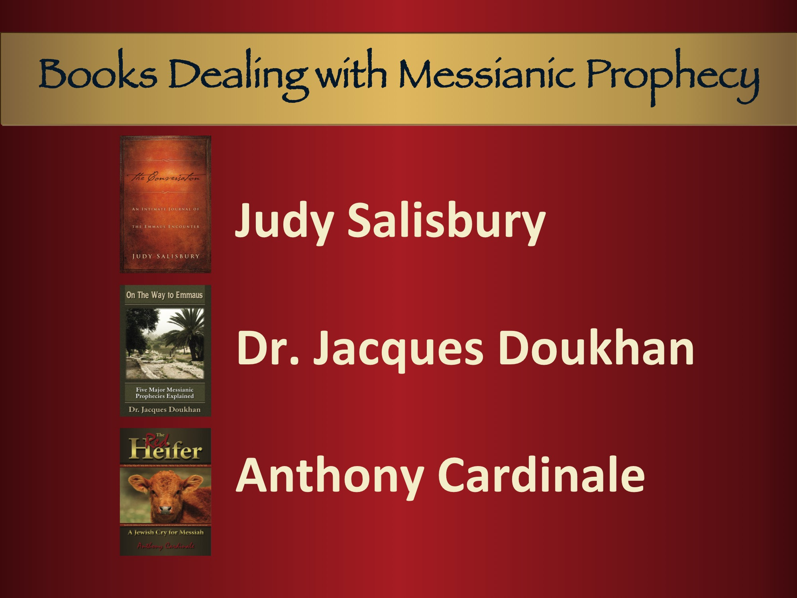
Notes:
The Conversation
An Intimate Journal of the Emmaus Encounter
—Judy Salisbury
“The Conversation brings to life that famous encounter between the two disciples and our Lord Jesus on the road to Emmaus. While it is based in part on an imaginative reconstruction, it is filled with the throbbing pulse of the excitement of the sensational impact that our Lord’s resurrection should have on all of our lives.” ~ Dr. Walter Kaiser President Emeritus Gordon- Conwell Theological Seminary. 120 pages.
Hardback and Paperback
On The Way to Emmaus:
Searching the Messianic Prophecies
—Dr. Jacques Doukhan
An outstanding compilation of the most critical Messianic prophecies by a renowned conservative Christian Scholar, drawing on material from the Bible, Rabbinic sources, Dead Sea Scrolls, and more. 236 pages.
Paperback
The Red Heifer A Jewish Cry for Messiah —Anthony Cardinale
Award-winning journalist and playwright Anthony Cardinale has traveled extensively in Israel, and recounts here his interviews with Orthodox rabbis, secular Israelis, and Palestinian Arabs about the current search for a red heifer hoping to rebuild the Temple and bring the Messiah. 320 pages. Paperback

Slide 27
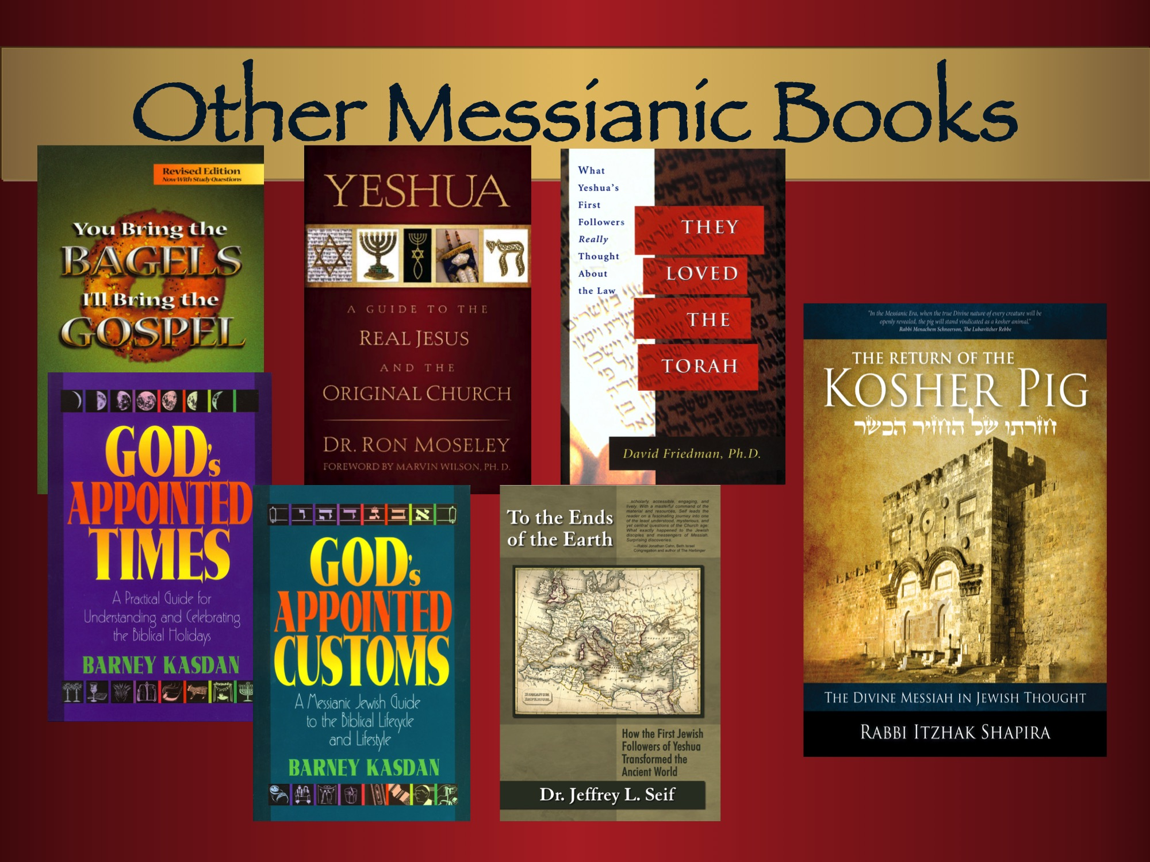
Notes:
You Bring the Bagels, I’ll Bring the Gospel
Sharing the Messiah with Your Jewish Neighbor Revised Edition
—Rabbi Barry Rubin
This “how-to-witness-to-Jewish-people” book is an orderly presentation of everything you need to share the Messiah with a Jewish friend. Includes Messianic prophecies, Jewish objections, words to avoid. 201 pages.
English
Spanish Te Tengo Buenas Noticias
Yeshua
A Guide to the Real Jesus and the Original Church
—Dr. Ron Moseley
Dr. Moseley never flinches from showing “Jesus was a Jew, who was born, lived, and died, within first century Judaism.” He explains idioms in the New Testament. 213 pages.
Paperback
They Loved the Torah
What Yeshua’s First Followers Really Thought About the Law
—Dr. David Friedman
Although many Jews believe that Paul taught against the Law, this book disproves that notion. An excellent case for his premise that all the earliest followers of the Messiah were not only Torah-observant, but also desired to spread their love for God’s entire Word to the Gentiles. 144 pages.
Paperback
God’s Appointed Times
A Practical Guide to Understanding and Celebrating the Biblical Holidays
—Rabbi Barney Kasdan
The Biblical Holy Days teach us about the nature of God and his plan for mankind. Includes historical background, traditional Jewish observance, New Testament relevance, and prophetic significance. 145 pages.
Paperback
God’s Appointed Customs
A Messianic Jewish Guide to the Biblical Lifecycle and Lifestyle
—Rabbi Barney Kasdan
Explains how biblical customs are often the missing key to unlocking the depths of Scripture. Companion to God’s Appointed Times. 170 pages.
English and Spanish
To the Ends of the Earth
How the First Jewish Followers of Yeshua Transformed the Ancient World
—Dr. Jeffrey Seif
Everyone knows that the first followers of Yeshua were Jews, and that Christianity was very Jewish for the first 50-100 years. Read the truth of how these early Messianic Jews influenced and transformed the known world. 224 pages.
Paperback
Return of the Kosher Pig
The Divine Messiah in Jewish Thought
—Rabbi Tzahi Shapira
Far from a study of kosher dietary laws, this book is an unprecedented journey toward the true identity of the Divine Messiah—the one previously considered “unkosher” and “unacceptable” by Jewish people. This encyclopedic volume will surprise and challenge you with the compelling words of Jewish sages and rabbis over the last 2,000 years, many in English for the first time. 352 pages.
“One of the most interesting and learned tomes I have ever read. ….Rabbi Shapria’s remarkable book cannot be ignored.”
—Dr. Paige Patterson, Pres. SW Baptist Theological Seminary
Paperback

Slide 28
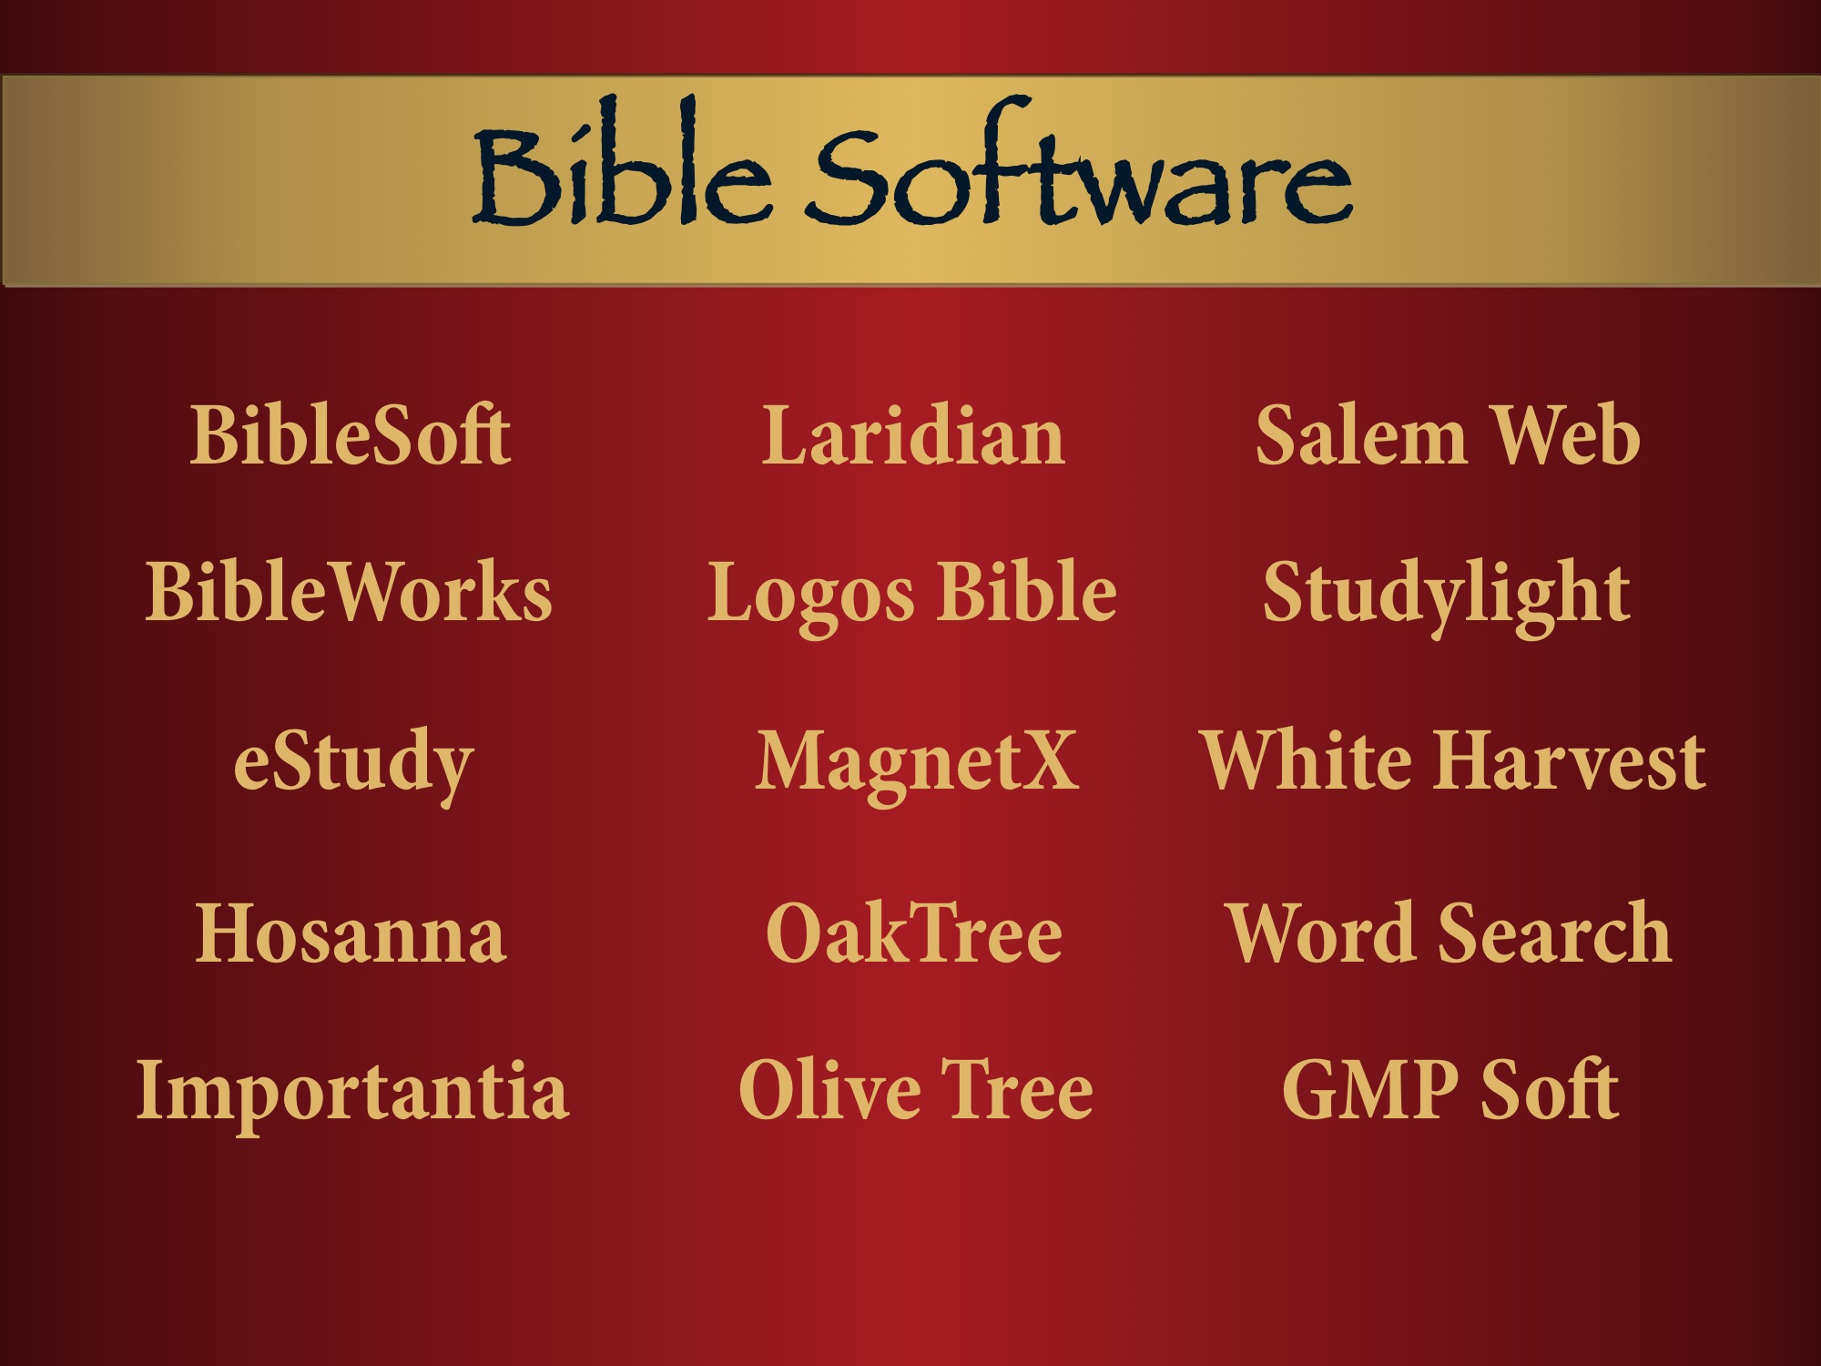
Notes:
Already in these software applications, the JNT and CJB are also available through Crosswalk.com/BibleStudyTools.com and soon to be released on YouVersion.

Slide 29
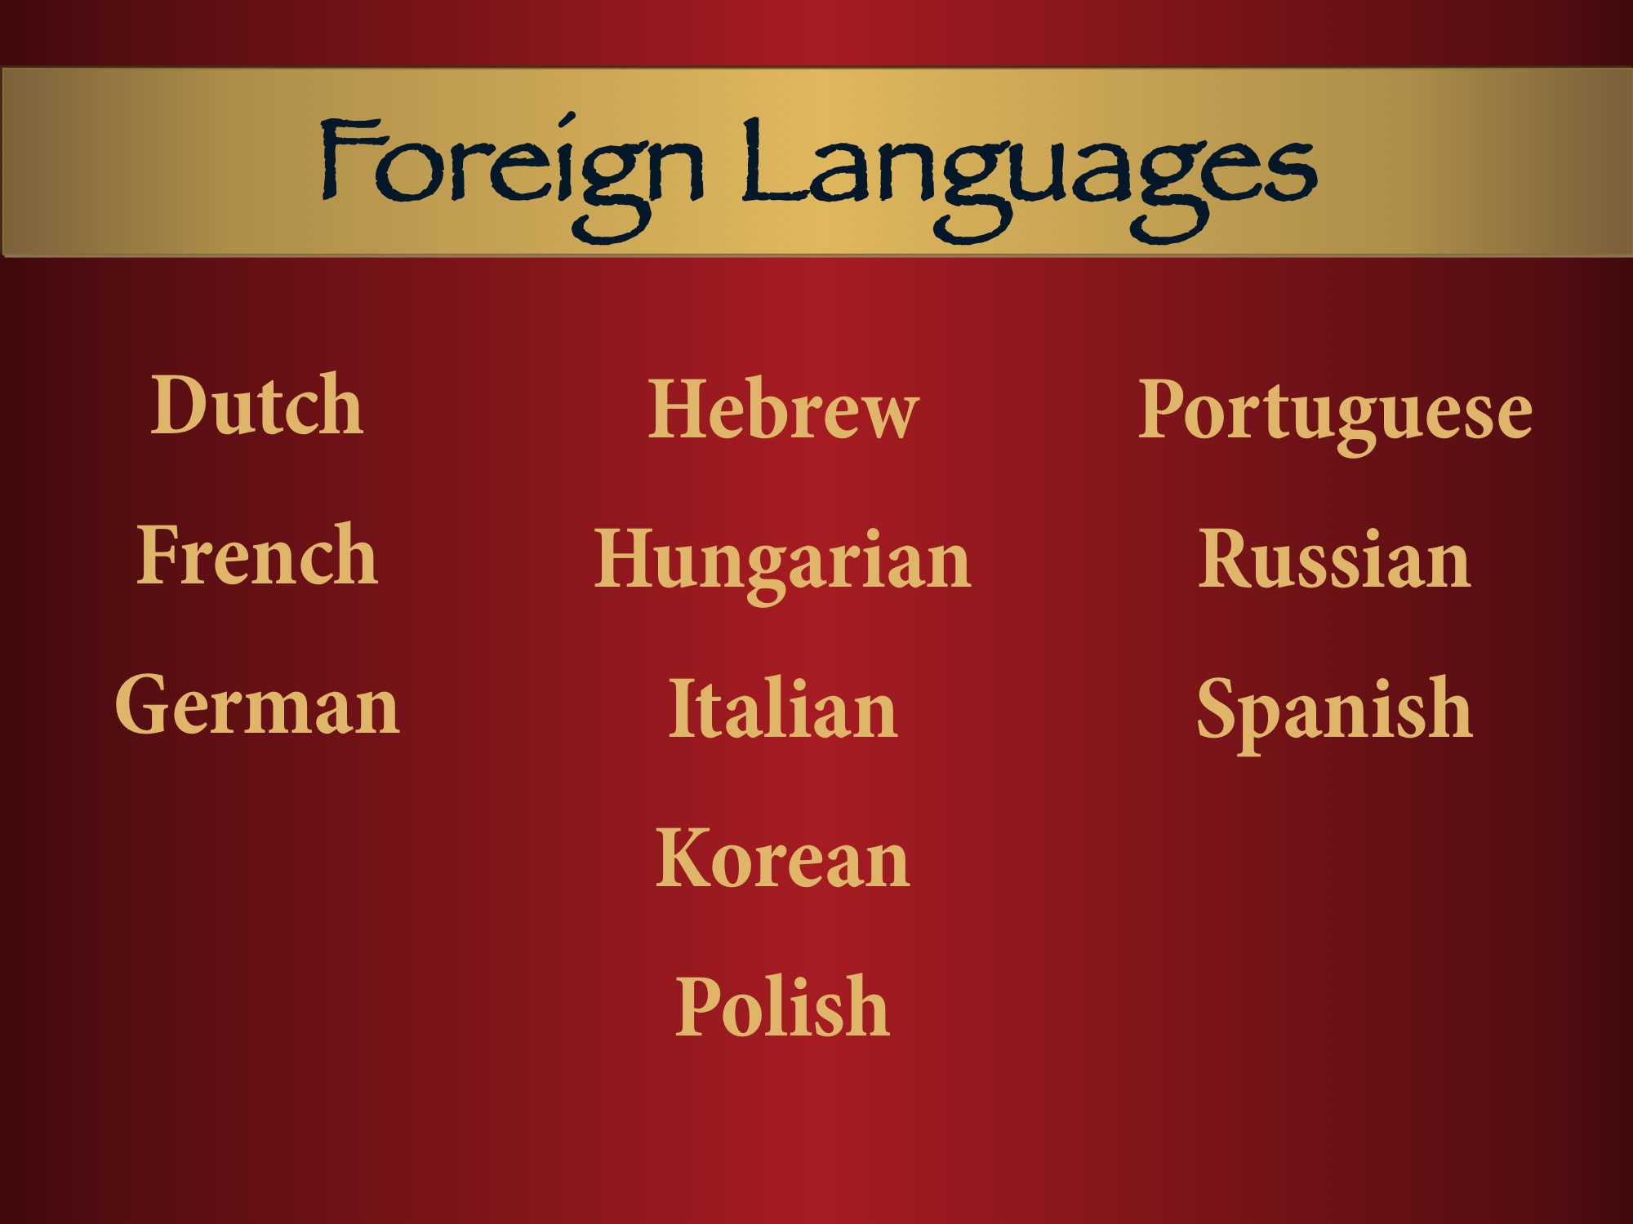
Notes:
In addition to these languages, several more are being worked on.

Slide 30

Notes:
We are looking for other contributors to the Commentary series, as well as authors of Messianic Jewish and Israel-related books. Please contact editor@messianicjewish.net

